Slide 1

Deloitte Lean Six Sigma Method.
Lean Six Sigma Training
Day 2 – Current State 1, Current State 2

Slide 2

Agenda Day 2 - Current State 1, Current State 2
Section 1 | Quiz from Day 1 Introduction to Current State 1
Section 2 | Voice of Customer (VOC) Critical to Quality (CTQ) Customer demand analysis
Section 3 | Value Flow and Identifying Waste Identify “Just do it” activities Simulation Round 2 Record and review simulation performance
Section 4 | Introduction to Current State 2 Seeing is believing Value Stream Mapping
Section 5 | Exercise – Value Stream Mapping Exercise – Identifying Value Add / Non Value Add Steps
Section 6 | Typical Workshop Agenda Day 2 Review & Wrap up

Slide 3
Quiz What can you remember from Day 1?
?

Slide 4
The Deloitte 5 Workshop Approach Where does today fit in the 5 Workshop approach?
M - Mobilisation Workshop
CS1 - As-Is High level Workshop
CS2 - As-Is Detail Workshop
FS1 - Future State Workshop
FS2 - Implementation Planning Workshop
WP - Running the
Work Pilot
Outputs
Project Kick-off
Finalised Scope
High-level process
Team Selected
High level plan agreed
Customer requirements
Plan interviews and current state mapping
Current State map
Report back to key stakeholders
Future State map
Report back to key stakeholders
Implementation plan & charters
Final Report back
Rapid execution of the quick hits and impro-vement opportunities identified
Confirm expected benefits
Initial identification of the quick wins to be refined and designed, ready to be executed
Key Activities
Lean Awareness
Validation of end to end process scope
Value tree analysis
Refine charter
Confirm data requirements
Identify design boundaries
Lean education by “doing” in a practical environment - team building
Review charter, SIPOC and demand
Understand who the customers are (VOC) and their requirements
Value Stream Flow
Plan for ‘seeing is believing’
Seeing is Believing - Walk the process to understand what really happens, how long it takes, and what the key issues are
Construct the current end to end value stream map
Conduct value and waste analysis; identify what is preventing the value to flow
Define blue sky vision and agree future state lean design principles
Map the future state
Highlight benefits
Identify the implementation work packages and draft charters
Prioritise work packages
Define a high-level implementation plan
Agree pilot content
Agree governance and gain stakeholder buy-in
Test & refine the new streamlined process in a safe environment
Implement visual management
Develop standardised operating procedures
Measure new KPIs
Up-date the front line knowledge base,
Plan transfer to BAU
Tools and techniques
Problem scoping
Identify process owners, suppliers, customers (SIPOC)
Value Tree
Data collection
Project Charter
Lean simulation game
VOC data & CTQ
Understand demand - Mississippi Chart
Runners, Repeaters and Strangers
Value tree
Seeing is Believing
Value stream mapping
Baseline Metrics
7 wastes analysis
Root cause analysis and problem-solving
5S analysis (work place management)
Lean design principles
Pull systems and one piece flow
Mistake proofing
Andon system
Takt time
Cycle time diagram
Load balancing
Leveling heijunka
Improvement Work Packages charters
Ease versus Impact assessment
Gantt chart
Work pilot mission
5S environment
Standard Work
Decision Trees
Skill matrix
KPI & Run charts
Control charts
Quality matrix, FMEA
Problem solving & 8D
Notes:
Version

Slide 5
Current State 1 What are the main objectives of the first Current State workshop?
Mobilisation
Current State
Future State
Implement improvements
Week -2
M | T |  | T | F
Week 1
M | T | W | T | F
Week 2
M | T | W | T | F
Week 3
M | T | W | T | F
Week 4
M | T | W | T | F
Week 5 12
M | T |  | T | F
M
CS1
CS2 – Map
FS1
FS2
Work pilot
M
Mobilisation: Kick-off, confirm scope, SIPOC, team – complete project charter
½ day
CS1
Current State 1: Lean Simulation, VOC, CTQ, value stream flow,
plan for ‘seeing is believing’
1 day
CS2
Current State 2: Seeing is believing, as-is value stream map
3 days
FS1
Future State 1: Value and waste analysis, blue sky vision, to-be value stream map
2 days
FS2
Future State 2: Work package definition and charters, prioritisation and high level plan
2 days
WP
Work Pilot: Test the changes and refine the design before roll-out
8 weeks

Slide 6
Agenda Day 2 - Current State 1, Current State 2
Section 1 | Quiz from Day 1 Introduction to Current State 1
Section 2 | Voice of Customer (VOC) Critical to Quality (CTQ) Customer demand analysis
Section 3 | Value Flow and Identifying Waste Identify “Just do it” activities Simulation Round 2 Record and review simulation performance
Section 4 | Introduction to Current State 2 Seeing is Believing Value Stream Mapping
Section 5 | Exercise – Value Stream Mapping Exercise – Identifying Value Add / Non Value Add Steps
Section 6 | Typical Workshop Agenda Day 2 Review & Wrap up

Slide 7
Tools & Techniques Lean originated with 5 core principles used to drive continuous improvement
Value
Precisely specify value from the customer’s perspective
Value Stream
Identify the value stream for each product or service
Identify value and the value stream
Sustain and CI
Flow
Create flow without interruptions
Establish Flow & Pull
Pull
Let the customer pull value from the producer
Perfection
Pursue perfection through continuous improvement
Reducing waste
Increasing speed & efficency
Notes:
Trainer/Facilitator to lead discussion about possible areas of conflict between customer needs & business needs

Slide 8
Tools & Techniques Lean originated with 5 core principles used to drive continuous improvement
Standard work
Voice of the Customer
Visual management
SIPOC
Problem solving
Identify value and the value stream
Go and See
Sustain and CI
5 S
Value Stream Mapping
Establish Flow & Pull
Mistake proofing
Pull systems
Cellular flow
Andon
Continuous flow
Takt time
Notes:
Trainer/Facilitator to lead discussion about possible areas of conflict between customer needs & business needs

Slide 9


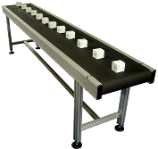

Understanding the process requirements Balancing Voice of the Customer with Voice of the Business & Process
Voice Of Customer
Voice Of Process
Voice Of Business
Our focus is to deliver more value, more effectively to our customers
But we also need to recognise business needs and current process capabilities to set realistic performance targets to ensure on-going profitable business
Notes:
Trainer/Facilitator to lead discussion about possible areas of conflict between customer needs & business needs

Slide 10







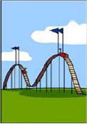

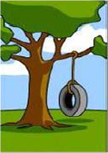
It is essential for a company’s success to really understand the voice of its customers
… how the customer explained it …
… how the project leader understood it it …
… how the analyst designed it …
… how the programmer wrote it …
… how the business consultantdescribed it …
… how the project was finally documented …
… how operations installed the result…
… how the customer was billed for it …
… how the the customer was supported …
… what the customer really wanted …
Notes:
Trainer/Facilitator to lead discussion about possible areas of conflict between customer needs & business needs

Slide 11
Voice of the Customer (VOC) Definition
Definition
Voice of the Customer identifies the needs to be satisfied by the product or service, expressed in the words of the Customers
The goal of Lean Six Sigma is to quantify VOC data into requirements or specifications in order to quantifiably meet those requirements
Organizations seek to drive business process output to meet Customer needs. All Lean Six Sigma process improvement efforts are directed by VOC data
Why is it important?
How is VOC used?
It is evidence of what an organization does well and what it needs to improve
It can enhance focus on what is truly important to the Customer rather than what is assumed to be important
It can drive focus on improving key areas/processes that are important to the Customer
To ensure that performance measures are in place for all needs critical to Customers
To prioritize areas of focus for improvement
To set performance targets for improvement effort
11

Slide 12
Collecting VOC Data VOC Data can be collected in two ways:
Actively — where the team develops a data collection plan and implements the plan such as interviews, focus groups, surveys, etc.
Passively — where the team receives VOC information from existing “Listening Posts” such as:
Customer Complaints
Returns
Customer service interactions
Trouble ticket data
Online product reviews
Staff feedback
Where Can We Listen to the VOC?
Complaints
Market Trends
Compliments
Customers
Returns
New Business
Surveys
12

Slide 13
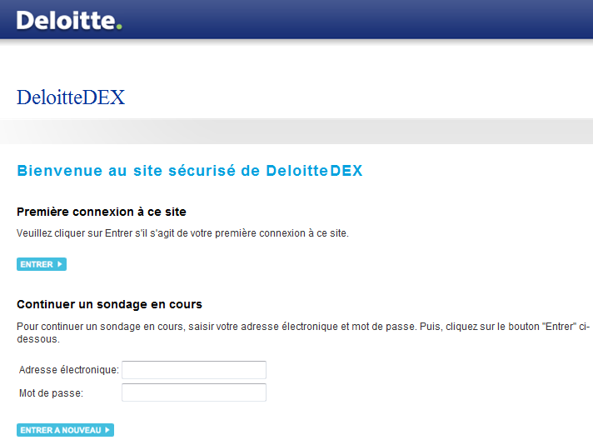
Collecting VOC Data Deloitte tool available
Notre outil d’enquête en ligne : DeloitteDEX
Type de questionnaire
Choix multiples et commentaires
En ligne (« web-based »)
Nombre limité de questions (~10)
Echantillon
Cibles : clients actuels et prospects ayant fourni leur adresse email à La Poste et / ou location d’un fichier qualifié
Process (proposition)
Envoi d’un mail introductif de la part de La Poste avec lien vers le questionnaire élaboré par Deloitte (outil propriétaire DeloitteDEX) ou envoi directement par l’équipe Deloitte
Relance automatique (délais à déterminer)
Proposition d’un lot à gagner pour améliorer le taux de réponse (résultats prouvés sur expériences antérieures, exemple de lot : iPad)
Confirmation statistique des propos identifiés de façon théorique grâce à nos études de marché
Recueil d’un nombre très important de réponses
Clarification des attentes et du processus d’achat client
13

Slide 14
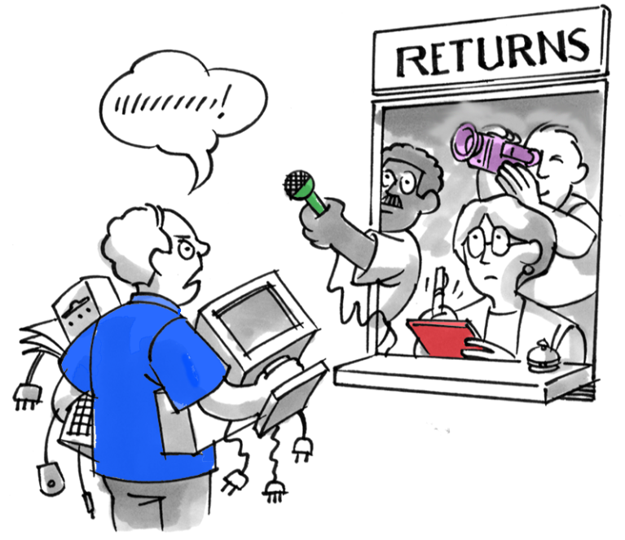
Collecting VOC Data VOC Data can be collected in two ways:
Objective: Identify who are the customers and what are their requirements
Key questions:
Who is/are the customer types?
What are the customers saying?
What are the issues we can deduct?
What are their requirements?
Team work:
Separate flipchart for each customer type
On each flipchart:
Customer type
Identify their main requirements
If needed, identify questions to be asked to the customers
14

Slide 15
Voice of the Customer Process Translating VOC into CTQs and performance targets
Customer needs expressed in ‘customer language’
Voice of Customer
AFFINITY
DIAGRAM
Customer needs expressed in ‘our language’
Customer needs
/ Issues
TRANSLATION
TABLE
Customer needs expressed in positive and measurable CTQs
(Critical to Quality)
CTQs
L MATRIX
The process output measures relating to that particular CTQ
Key Process measures
Notes:
CTQ stands for “Critical to Quality”
A CTQ must be stated in the positive (it is what the customer does need NOT what they don’t need). A CTQ must also be measurable

Slide 16
Voice of the Customer Process Translating VOC into CTQs and performance targets
Good definition of CTQ enables clear performance targets to be set
Voice of Customer | Key Issue | CTQ
“We need faster answer to our queries” The customer service rep didn’t have an answer to my questions” | Long response time | Response to customer within 1 hour
“I don’t like the changing delivery dates” | Hassle and uncertainty from changing deliveries | First promised delivery date always met
“ You can never tell me the right product for the job” | Poor technical advice | Customer service provides accurate product knowledge
Notes:
Make sure that the CTQ is Stated in the positive and is measurable (may not be something that is measured at the moment but must be something that could be measured if necessary)

Slide 17
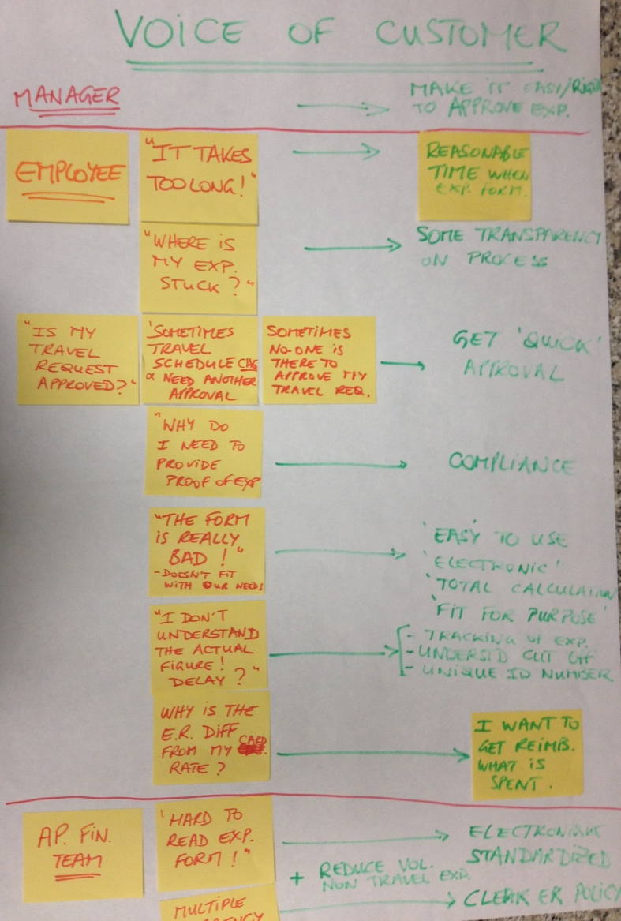
Understanding the Voice Of the Customer (VOC)
Identify who are the customers, their issues (what they are telling us) and what are their requirements which are “critical to quality”
Note that no formal VOC is captured on an on-going basis to understand the customers feedback on the T&E process and how it could be improved
Voice of Customer (VOC):
Customer finds it takes a very long time to claim back expenses, have them authorised and reimbursed
Customer struggles to complete the T&E form (not enough space, calculate subtotals manually…)
Customer does not know where his/her expenses are held in the process
Managers often don’t recognise the actual figures of the T&E actual costs against their budget
Customer requirements
The employee (customer) wants to get reimbursed exactly what he spent (in line with the policy)…
… within a reasonable time (two weeks)…
… using a simple and easy to fill T&E form.
17

Slide 18
Critical to quality example Investment Reporting – Critical to quality requirements
Insurance Company
A Voice of the Customer (VoC) analysis with the teams involved in an Investment Management Reporting processes produced the following process measures to be used by the Process Owner to manage the performance of the process.
Needs
Drivers
Critical to quality
Accuracy and completeness of investment data and commentary
Number of amendments made after final investment data has been submitted to reporting teams
◆
Number of queries raised by Investment Reporting (onshore) to Investment Reporting (offshore)
❖
To produce timely and accurate Investment reporting and analysis
Group Investment Performance Report, Counterparty / Admissibility report, Tax Report and Asset Quality report delivered within agreed delivery dates to the Reporting teams / Group Reporting timeframe
Timely provision of reports
⬥
Timely response to queries
Investment Reporting team are able to turn around queries raised by the Reporting teams within agreed delivery dates

18

Slide 19

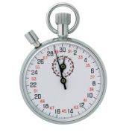
Exercise All Pizzas Great and Small – Voice of the Customer
45 minutes
Step 1
Step 2
Step 3
Split into groups
Each group will take the role of a different set of ‘interested parties’ in a business venture:
Customer 1
Customer 2
Delivery Staff
Kitchen Staff
Your facilitators are the managers of the business venture.
You will be assigned your ‘interested party’ role and asked by your facilitators to identify what makes for happy customers and contented staff
List your
VOC/ VOB needs
Key Issues
CTQs
Measures
Target Specs
... and be prepared to share them with the group when we meet back up!
Notes:
Need an even number of groups. In this explanation we will assume that there are two groups of approximately five people.
One group is the board of regional managers for a cinema chain, the other group are the potential customers of a cinema that is about to be opened by the chain
Facilitator will play the role of the manager for the new cinema. The facilitator will ask each group; “what are your requirements for the new cinema?”
Expect the requirements from either group to differ. Use the exercise to introduce the idea that the customer’s requirements are the most important thing and that if they are not taken into account, then the wrong expectations will be met, even if you follow the business’ requirements

Slide 20
Exercise All Pizzas Great and Small – Example Answer
Based on the VOC,VOB and process data collected, the performance goals are established
The team believe that achieving these goals should be sufficient to restore sales
The next challenge is analysing and improving the process in order to reliably and consistently meet the challenging targets!
Examples:
VOC | Key Issue | CTQ | Performance Measure | Target Spec
“Your Pizzas are always cold” | Cold unappetising Pizza | Warm Pizza when received from Delivery van | Temp of Pizza in the centre | 68 – 70 deg C
“You never deliver within the time you promise in your ads” | Delivery is late | Delivery within 30 mins from order | Delivery Lead Time | < 30 minute

Slide 21
Customer demand analysis Demand types - Runners, Repeaters, Strangers & Aliens (RRSA)
Demand is often classified into 4 categories:
Runners (0 – 80%): family of Products or items that needs to be processed regularly in large volume (Usually represent about 80% of the volume throughput)
Repeaters (80 – 95%): intermediate volumes but reasonably regular
Strangers (95 – 99%): unusual or special products/items that are processed relatively infrequently and need special attention
Aliens (99 – 100%): one off runs produced very rarely
Leading to specific design solutions:
Separate Strangers into different value stream or process flows where they can be handled by specialised team
Schedule dedicated time every day or week for repeaters within workflow run mainly for runners
?
What happens to flow if you mix up Strangers with Runners in the same value stream?

Slide 22
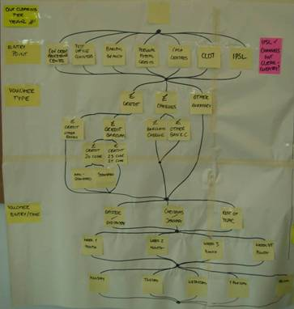
Customer demand analysis It is important to understand the demand that flows through the value stream
Objective: Identify the flow of demand hitting the process
Key questions:
What is the current product universe?
What kind of „demand“ is hitting the system?
What triggers the Value Stream?
How can the ‘demand’ be looked at or categorized?
Team work:
Brainstorm ways in which demand can be measured (daily volumes; highs & lows; variances; peaks)
Brainstorm ways in which demand can be categorised (eg: by product type; by channel,; by customer purpose; by request type; by value & failure demand; by location; by team…)
Select most useful categories
List actual demand hitting the system known in blue and the best estimates in green

Slide 23
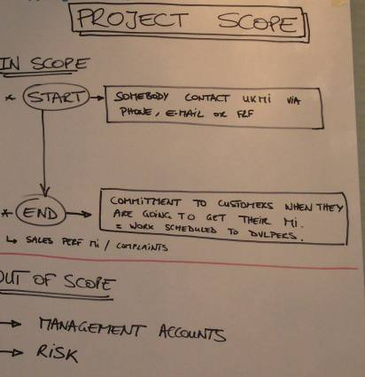
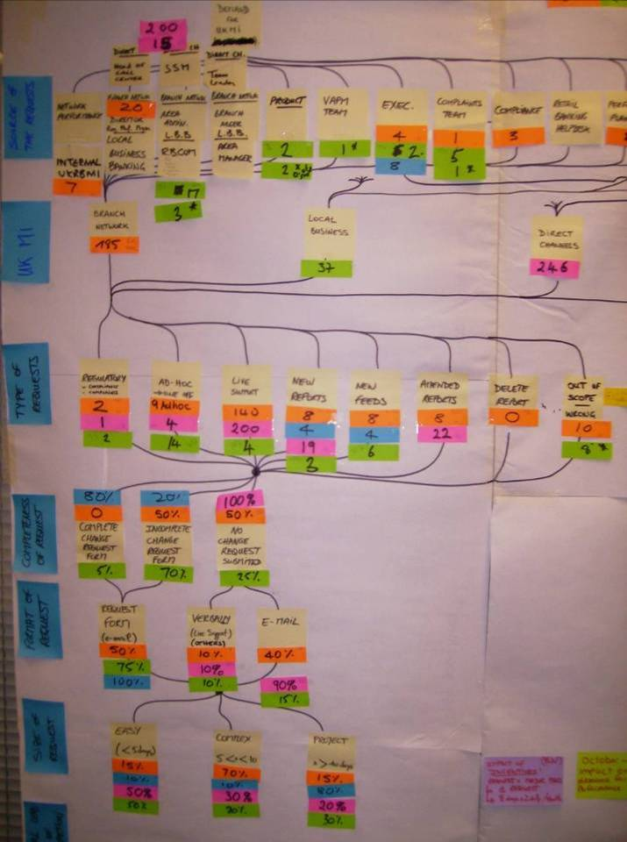
Customer demand analysis Mississippi chart in practice
Step 1: Define the scope of the process (where does it start, where does it end) and the products/services delivered to the customer(s)
Step 3: create the charts using post-its:
- Place the categories on the left hand side of the chart & organise them in the order of the flow when possible
- Identify the compo-nents within each category and place them of the chart
- Draw the links between the components
Step 2: Brainstorm ways in which category the demand can be classified:
What kind of „demand“ is hitting the system?
What triggers the Value Stream?
Note: The flow can diverge and converge as it goes through the different categories
Step 4 & 5: Populate the chart with the actual demand hitting the system for the selected measurements & categorisation
Note: Colored post-it can be used for different measures or different products
Step 6: Identify key insights form the chart

Slide 24

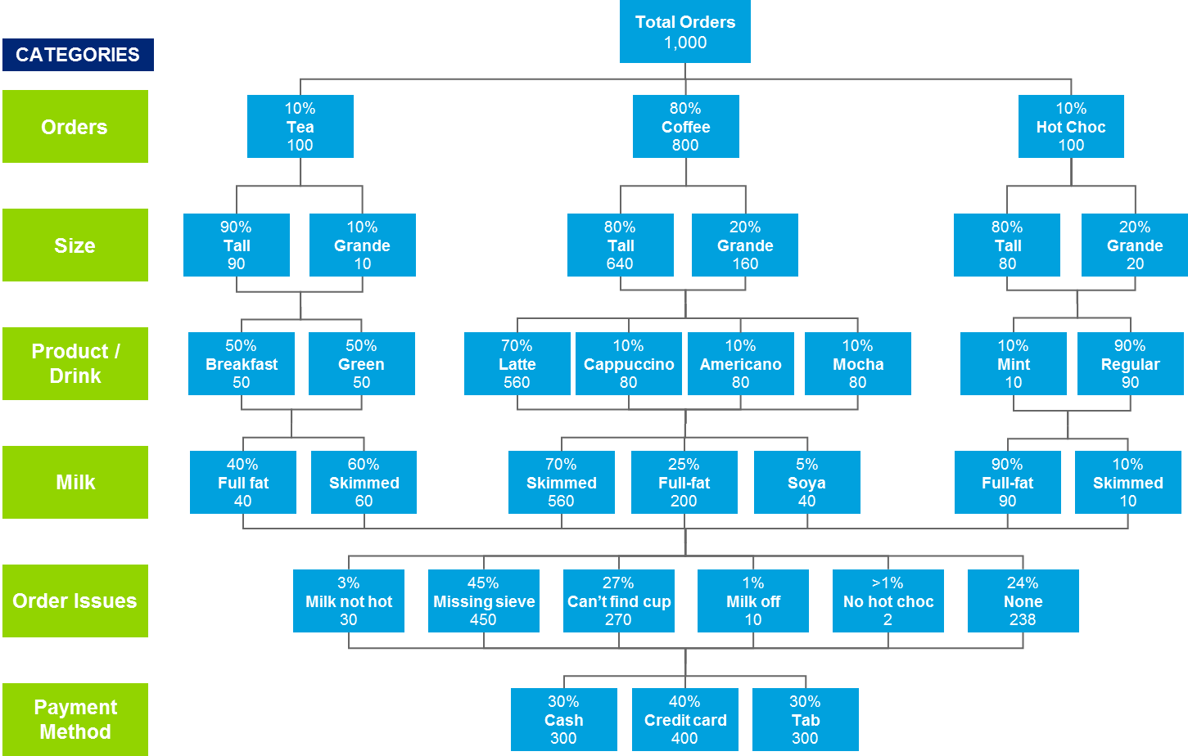
Exercise Mississippi Chart – Starbucks
2 minutes
Starbucks have created the following Mississippi chart.
What conclusions can be made?

Slide 25
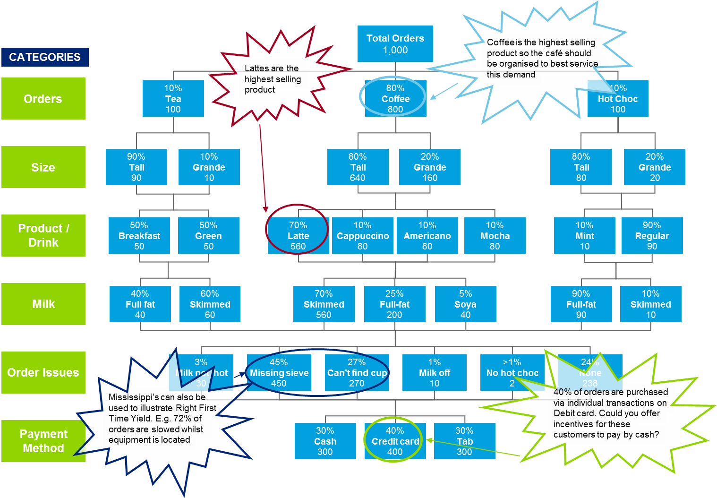
Exercise – Sample answer Mississippi Chart – Starbucks

Slide 26
Agenda Day 2 - Current State 1, Current State 2
Section 1 | Quiz from Day 1 Introduction to Current State 1
Section 2 | Voice of Customer (VOC) Critical to Quality (CTQ) Customer demand analysis
Section 3 | Value Flow and Identifying Waste Identify “Just do it” activities Simulation Round 2 Record and review simulation performance
Section 4 | Introduction to Current State 2 Seeing is Believing Value Stream Mapping
Section 5 | Exercise – Value Stream Mapping Exercise – Identifying Value Add / Non Value Add Steps
Section 6 | Typical Workshop Agenda Day 2 Review & Wrap up

Slide 27
Key activities before observing the process Develop the team’s understanding of what we will be looking for
Framing the work with the project team, starting with validating the scope of project through to establishing the customer critical requirements:
Validate the scope
VoC and CTQ
Preparation to CS2
Validate the problem statement and the scope with the team
Review the charter
SIPOC to agree on the key outputs as well as up to 5 high-level process steps
Identify who are the customers
Identify what are their critical requirements
And how the customer demand is actually flowing through the process / system (Mississippi diagram)
Establish the high level Value Stream Flow
Introduce the concept of value add and waste
Develop an eye for improvement (spot the “Just do it” activities)
Plan the “seeing is believing” observation
✓
✓
Notes:
Take the high level steps in the process and create a post-it for each
Lay the post-its in the order in which they happen within the process taking account of the parallel nature of certain steps
You may wish to consider if flow is ‘pull’ or ‘push’ within the high level process flow diagram
Following on from this, after ‘seeing is believing’ each step will be mapped within the Value Stream Map

Slide 28
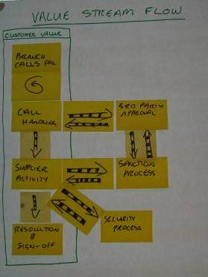
Value Stream Flow Develop understanding of where value is added in the process
Objective: Establish what the whole end to end value stream will look like
Key questions:
The Value Stream Flow shows the process flow for each of the process steps
Do we all agree on the key process steps? How is the value stream structured?
What are the key areas we will have to drill into?
Team work:
Using SIPOC, create the Value Stream Flow which helps to picture the whole end to end value stream
Confirm the “product(s)” to be followed and mapped
Agree on major Value Stream steps
Establish the details we would need to map the value stream (ex: access to the system, examples of good/bad products, leadtime and process time information…)
Legend
‘Item’ being pushed to the next step in the process = PUSH
Process step triggered by customer demand signal = PULL
Notes:
Take the high level steps in the process and create a post-it for each
Lay the post-its in the order in which they happen within the process taking account of the parallel nature of certain steps
You may wish to consider if flow is ‘pull’ or ‘push’ within the high level process flow diagram
Following on from this, after ‘seeing is believing’ each step will be mapped within the Value Stream Map

Slide 29
Waste is just the symptom
We need to identify and treat the “Flu Virus” of the Office Environment
In lean terms, waste is anything that adds costs or time without adding value
Additional toxic effects:
Physical fatigue
Emotional fatigue
Increased frustration
Increased stress
Placement of blame
Decreased self-worth
Indecisiveness
self-generating
ROOT
CAUSE
WASTE
Non-value adding activity
The ultimate Lean Six Sigma objective is the total elimination of waste
29

Slide 30
Waste is work that adds cost but doesn’t add value We need to identify and treat the “Flu Virus” of the Office Environment
Value-added activity
Work that directly increases the value of the product in the eyes of the customer; what the customer is paying for
Waste
Work or use of resources that does not add any value to a product. Waste is sometimes called ‘muda,’ from the Japanese for waste
Value- added activity
Waste
Elements of work
Business value add
Objective
The objective is to maximize the proportion of value-added activity by eliminating waste and incidental activity
Business value add
Work that does not directly add customer value, but is currently necessary to maintain operations
30

Slide 31

Recognizing Waste There are 8 different types of waste in a process (TIMWOODS)
Waste can be defined as any aspect of an activity, task or process that adds no value to the final product or service. It can be grouped into 8 categories, which help to spot it in a process
Transportation
1
Skills
8
2
Inventory
Defects
7
3
Motion
Over-
processing
6
4
Waiting
5
Over-production
31
Notes:
Waste for service environment:
Transport – Any unnecessary movement of material, products, documents or information can be described as waste. This reflects on activities moving from one individual to another, within departments or between departments, which adds time to the overall process. In
the service environment, this manifests itself as tasks to be collected and delivered, physically or virtually.
Inventory - It’s the physical piles of un-cleared inboxes, list of pending enquiries or emails or time a client spends in a queue.
Motion - It is the unnecessary movement of people or resources. The physical movement of personnel from a station to another to continue a process is an example of motion. Others include the switching between computer terminals or databases, is a form of motion, which requires additional steps to be executed before a truly value-adding step can be carried out.
Waiting - It is the elapsed time between the end of a process step or activity to the beginning of another. Waiting may have a direct or indirect impact to the customer. The time spent waiting between processes results in customers having to wait for the delivery the service.
Over processing - Generically, Over-Processing means adding more work to the service than necessary, trying to exceed the customers’ requirement. This in-fact translates to adding more value to a service than what a customer is willing to pay for. These are typically caused by not clearly understanding the customer’s requirement or having to manage redundancy in process.
Over production - Over-Production is the use of capacity and capability beyond the mean of the present service or product requirement, resulting in outputs that are not delivered to customers. Over-production, in a sense, is work carried out ahead of customers’ need and
can also result is wastes as the services are performed without the clear understanding the customer’s requirement or when there is no demand from the customer.
Defects - The waste of defect is always seen when nonconformity exists. When products or services do not conform to a customer’s demand, then it’s a defect, and all effort in time, resources, materials and cost are wasted. There is a price to pay for non-conformity.
For an organization, it has produced work or service that a customer in not willing to pay for – and ultimately driving the customer to see an alternate provider for the products and services. Typically, the voice of customer is heard when a defect occurs, in the form of complaints. And many organizations engage in improving the complaints handling processes and fail to focus on the process value stream to identify where the defect occurs. Eliminating the root cause of defects presents a lasting solution to eliminating this waste.

Slide 32

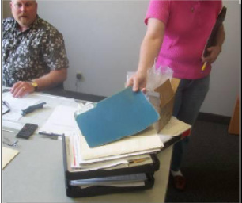
Recognizing Waste Transportation
Supply Chain | Finance Processes | IT Development | Healthcare
Moving parts or equipment in and out of storage Moving materials from one area to another Moving parts between Processes | Retrieving or storing files Carry documents to and from shared equipment Taking files to another person, hand-off Going to get signatures | Unplanned task switching Developing duplicate functionality by not bundling similar requests | Moving patients from area to area Moving samples and specimens Moving patient’s notes Moving equipment from area to area
Movement of products
Passing the file to another department
32
Notes:
Waste for service environment:
Transport – Any unnecessary movement of material, products, documents or information can be described as waste. This reflects on activities moving from one individual to another, within departments or between departments, which adds time to the overall process. In
the service environment, this manifests itself as tasks to be collected and delivered, physically or virtually.
Inventory - It’s the physical piles of un-cleared inboxes, list of pending enquiries or emails or time a client spends in a queue.
Motion - It is the unnecessary movement of people or resources. The physical movement of personnel from a station to another to continue a process is an example of motion. Others include the switching between computer terminals or databases, is a form of motion, which requires additional steps to be executed before a truly value-adding step can be carried out.
Waiting - It is the elapsed time between the end of a process step or activity to the beginning of another. Waiting may have a direct or indirect impact to the customer. The time spent waiting between processes results in customers having to wait for the delivery the service.
Over processing - Generically, Over-Processing means adding more work to the service than necessary, trying to exceed the customers’ requirement. This in-fact translates to adding more value to a service than what a customer is willing to pay for. These are typically caused by not clearly understanding the customer’s requirement or having to manage redundancy in process.
Over production - Over-Production is the use of capacity and capability beyond the mean of the present service or product requirement, resulting in outputs that are not delivered to customers. Over-production, in a sense, is work carried out ahead of customers’ need and
can also result is wastes as the services are performed without the clear understanding the customer’s requirement or when there is no demand from the customer.
Defects - The waste of defect is always seen when nonconformity exists. When products or services do not conform to a customer’s demand, then it’s a defect, and all effort in time, resources, materials and cost are wasted. There is a price to pay for non-conformity.
For an organization, it has produced work or service that a customer in not willing to pay for – and ultimately driving the customer to see an alternate provider for the products and services. Typically, the voice of customer is heard when a defect occurs, in the form of complaints. And many organizations engage in improving the complaints handling processes and fail to focus on the process value stream to identify where the defect occurs. Eliminating the root cause of defects presents a lasting solution to eliminating this waste.

Slide 33
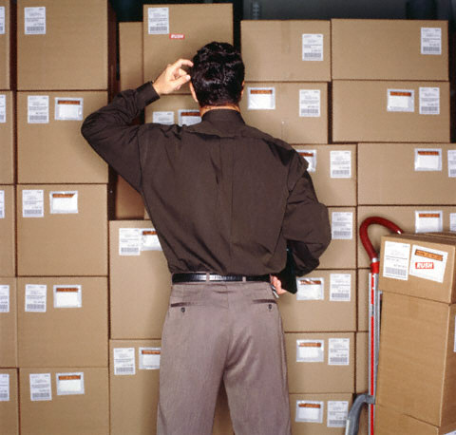
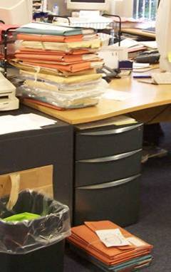

Recognizing Waste Inventory
Supply Chain | Finance Processes | IT Development | Healthcare
Raw materials Work in progress Sub-assemblies Finished goods Consumable stores Off site inventory | Files waiting to be worked on Open projects Office supplies Emails waiting to be read Unused records in a Database | Gateway queues Batch processing Maintenance backlogs Large number of partially completed requests in the pipeline | Pharmacy stocks Lab supplies Samples Specimens waiting analysis Paperwork in process Patients in ward beds
Files waiting to be worked on
33
Notes:
Waste for service environment:
Transport – Any unnecessary movement of material, products, documents or information can be described as waste. This reflects on activities moving from one individual to another, within departments or between departments, which adds time to the overall process. In
the service environment, this manifests itself as tasks to be collected and delivered, physically or virtually.
Inventory - It’s the physical piles of un-cleared inboxes, list of pending enquiries or emails or time a client spends in a queue.
Motion - It is the unnecessary movement of people or resources. The physical movement of personnel from a station to another to continue a process is an example of motion. Others include the switching between computer terminals or databases, is a form of motion, which requires additional steps to be executed before a truly value-adding step can be carried out.
Waiting - It is the elapsed time between the end of a process step or activity to the beginning of another. Waiting may have a direct or indirect impact to the customer. The time spent waiting between processes results in customers having to wait for the delivery the service.
Over processing - Generically, Over-Processing means adding more work to the service than necessary, trying to exceed the customers’ requirement. This in-fact translates to adding more value to a service than what a customer is willing to pay for. These are typically caused by not clearly understanding the customer’s requirement or having to manage redundancy in process.
Over production - Over-Production is the use of capacity and capability beyond the mean of the present service or product requirement, resulting in outputs that are not delivered to customers. Over-production, in a sense, is work carried out ahead of customers’ need and
can also result is wastes as the services are performed without the clear understanding the customer’s requirement or when there is no demand from the customer.
Defects - The waste of defect is always seen when nonconformity exists. When products or services do not conform to a customer’s demand, then it’s a defect, and all effort in time, resources, materials and cost are wasted. There is a price to pay for non-conformity.
For an organization, it has produced work or service that a customer in not willing to pay for – and ultimately driving the customer to see an alternate provider for the products and services. Typically, the voice of customer is heard when a defect occurs, in the form of complaints. And many organizations engage in improving the complaints handling processes and fail to focus on the process value stream to identify where the defect occurs. Eliminating the root cause of defects presents a lasting solution to eliminating this waste.

Slide 34

Recognizing Waste Motion
Supply Chain | Finance Processes | IT Development | Healthcare
Searching for materials, components, drawings or documents Reaching for tools Lifting boxes of components Walking away to bring tools to area | Searching for files Additional keystrokes or clicks Clearing away files from a desk Gathering information Searching through manuals or catalogues | Switching between different software screens, domains Requests not tied to business-critical priorities Ineffective prioritization of maintenance requests | Searching for patients, medical staff, charts and records Gathering together tools or equipment, supplies Handling paperwork
Movement of people
Searching for things
34
Notes:
Waste for service environment:
Transport – Any unnecessary movement of material, products, documents or information can be described as waste. This reflects on activities moving from one individual to another, within departments or between departments, which adds time to the overall process. In
the service environment, this manifests itself as tasks to be collected and delivered, physically or virtually.
Inventory - It’s the physical piles of un-cleared inboxes, list of pending enquiries or emails or time a client spends in a queue.
Motion - It is the unnecessary movement of people or resources. The physical movement of personnel from a station to another to continue a process is an example of motion. Others include the switching between computer terminals or databases, is a form of motion, which requires additional steps to be executed before a truly value-adding step can be carried out.
Waiting - It is the elapsed time between the end of a process step or activity to the beginning of another. Waiting may have a direct or indirect impact to the customer. The time spent waiting between processes results in customers having to wait for the delivery the service.
Over processing - Generically, Over-Processing means adding more work to the service than necessary, trying to exceed the customers’ requirement. This in-fact translates to adding more value to a service than what a customer is willing to pay for. These are typically caused by not clearly understanding the customer’s requirement or having to manage redundancy in process.
Over production - Over-Production is the use of capacity and capability beyond the mean of the present service or product requirement, resulting in outputs that are not delivered to customers. Over-production, in a sense, is work carried out ahead of customers’ need and
can also result is wastes as the services are performed without the clear understanding the customer’s requirement or when there is no demand from the customer.
Defects - The waste of defect is always seen when nonconformity exists. When products or services do not conform to a customer’s demand, then it’s a defect, and all effort in time, resources, materials and cost are wasted. There is a price to pay for non-conformity.
For an organization, it has produced work or service that a customer in not willing to pay for – and ultimately driving the customer to see an alternate provider for the products and services. Typically, the voice of customer is heard when a defect occurs, in the form of complaints. And many organizations engage in improving the complaints handling processes and fail to focus on the process value stream to identify where the defect occurs. Eliminating the root cause of defects presents a lasting solution to eliminating this waste.

Slide 35

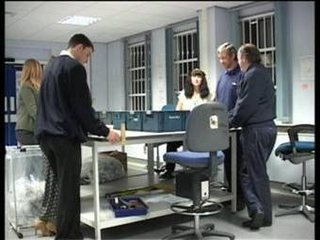
Recognizing Waste Waiting
Supply Chain | Finance Processes | IT Development | Healthcare
Waiting for parts or drawings Waiting for information Waiting for machine repairs Waiting for people | Waiting for emails, faxes, letters Waiting for computers Queuing at the photocopier Waiting for people to make decisions Meetings | Key resources not unavailable Developers idling due to incomplete information on the request forms | Waiting for beds and admissions Waiting for tests, treatment or discharge Waiting for test results
The team all start work at 3am in the post room
– but the post doesn’t arrive until 3.30!
35
Notes:
Waste for service environment:
Transport – Any unnecessary movement of material, products, documents or information can be described as waste. This reflects on activities moving from one individual to another, within departments or between departments, which adds time to the overall process. In
the service environment, this manifests itself as tasks to be collected and delivered, physically or virtually.
Inventory - It’s the physical piles of un-cleared inboxes, list of pending enquiries or emails or time a client spends in a queue.
Motion - It is the unnecessary movement of people or resources. The physical movement of personnel from a station to another to continue a process is an example of motion. Others include the switching between computer terminals or databases, is a form of motion, which requires additional steps to be executed before a truly value-adding step can be carried out.
Waiting - It is the elapsed time between the end of a process step or activity to the beginning of another. Waiting may have a direct or indirect impact to the customer. The time spent waiting between processes results in customers having to wait for the delivery the service.
Over processing - Generically, Over-Processing means adding more work to the service than necessary, trying to exceed the customers’ requirement. This in-fact translates to adding more value to a service than what a customer is willing to pay for. These are typically caused by not clearly understanding the customer’s requirement or having to manage redundancy in process.
Over production - Over-Production is the use of capacity and capability beyond the mean of the present service or product requirement, resulting in outputs that are not delivered to customers. Over-production, in a sense, is work carried out ahead of customers’ need and
can also result is wastes as the services are performed without the clear understanding the customer’s requirement or when there is no demand from the customer.
Defects - The waste of defect is always seen when nonconformity exists. When products or services do not conform to a customer’s demand, then it’s a defect, and all effort in time, resources, materials and cost are wasted. There is a price to pay for non-conformity.
For an organization, it has produced work or service that a customer in not willing to pay for – and ultimately driving the customer to see an alternate provider for the products and services. Typically, the voice of customer is heard when a defect occurs, in the form of complaints. And many organizations engage in improving the complaints handling processes and fail to focus on the process value stream to identify where the defect occurs. Eliminating the root cause of defects presents a lasting solution to eliminating this waste.

Slide 36
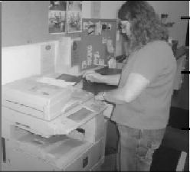
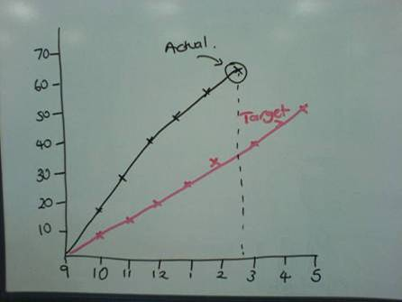
Recognizing Waste Over-production
Supply Chain | Finance Processes | IT Development | Healthcare
Producing for stock Working in large batches to avoid set ups Adding ‘scrap’ allowances | Giving more detail than is necessary Giving the customer too much detail Producing reports that nobody reads Making extra copies | Fulfilling request not to be used in next 3 months Processing in batch | Medicines given early to suit staff schedules Treatments done to balance hospital workload
Duplicating copies (paper and electronic)
Working faster than the target and finishing earlier than the customer requires
36
Notes:
Waste for service environment:
Transport – Any unnecessary movement of material, products, documents or information can be described as waste. This reflects on activities moving from one individual to another, within departments or between departments, which adds time to the overall process. In
the service environment, this manifests itself as tasks to be collected and delivered, physically or virtually.
Inventory - It’s the physical piles of un-cleared inboxes, list of pending enquiries or emails or time a client spends in a queue.
Motion - It is the unnecessary movement of people or resources. The physical movement of personnel from a station to another to continue a process is an example of motion. Others include the switching between computer terminals or databases, is a form of motion, which requires additional steps to be executed before a truly value-adding step can be carried out.
Waiting - It is the elapsed time between the end of a process step or activity to the beginning of another. Waiting may have a direct or indirect impact to the customer. The time spent waiting between processes results in customers having to wait for the delivery the service.
Over processing - Generically, Over-Processing means adding more work to the service than necessary, trying to exceed the customers’ requirement. This in-fact translates to adding more value to a service than what a customer is willing to pay for. These are typically caused by not clearly understanding the customer’s requirement or having to manage redundancy in process.
Over production - Over-Production is the use of capacity and capability beyond the mean of the present service or product requirement, resulting in outputs that are not delivered to customers. Over-production, in a sense, is work carried out ahead of customers’ need and
can also result is wastes as the services are performed without the clear understanding the customer’s requirement or when there is no demand from the customer.
Defects - The waste of defect is always seen when nonconformity exists. When products or services do not conform to a customer’s demand, then it’s a defect, and all effort in time, resources, materials and cost are wasted. There is a price to pay for non-conformity.
For an organization, it has produced work or service that a customer in not willing to pay for – and ultimately driving the customer to see an alternate provider for the products and services. Typically, the voice of customer is heard when a defect occurs, in the form of complaints. And many organizations engage in improving the complaints handling processes and fail to focus on the process value stream to identify where the defect occurs. Eliminating the root cause of defects presents a lasting solution to eliminating this waste.

Slide 37
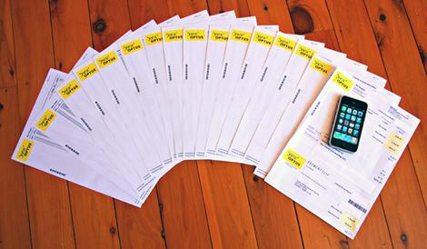
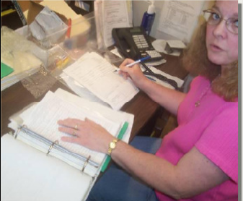

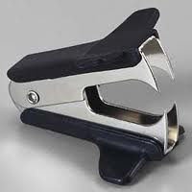
Recognizing Waste Over-processing
Supply Chain | Finance Processes | IT Development | Healthcare
Unnecessary operations Unnecessary packaging Over-tight tolerances Bad design Multiple cleaning | Creating reports Repeated entry of data Use of obsolete standard forms Use of inappropriate software Numerous signatures required for approval | Unnecessary functionality Fields populated with data not used by downstream process Unnecessary processing of information | Multiple bed moves Retesting Excessive paperwork Unnecessary procedures Multiple testing
Taking un-needed steps to process the goods / service (e.g. re-checking)
Providing higher quality than the customer wants
37
Notes:
Waste for service environment:
Transport – Any unnecessary movement of material, products, documents or information can be described as waste. This reflects on activities moving from one individual to another, within departments or between departments, which adds time to the overall process. In
the service environment, this manifests itself as tasks to be collected and delivered, physically or virtually.
Inventory - It’s the physical piles of un-cleared inboxes, list of pending enquiries or emails or time a client spends in a queue.
Motion - It is the unnecessary movement of people or resources. The physical movement of personnel from a station to another to continue a process is an example of motion. Others include the switching between computer terminals or databases, is a form of motion, which requires additional steps to be executed before a truly value-adding step can be carried out.
Waiting - It is the elapsed time between the end of a process step or activity to the beginning of another. Waiting may have a direct or indirect impact to the customer. The time spent waiting between processes results in customers having to wait for the delivery the service.
Over processing - Generically, Over-Processing means adding more work to the service than necessary, trying to exceed the customers’ requirement. This in-fact translates to adding more value to a service than what a customer is willing to pay for. These are typically caused by not clearly understanding the customer’s requirement or having to manage redundancy in process.
Over production - Over-Production is the use of capacity and capability beyond the mean of the present service or product requirement, resulting in outputs that are not delivered to customers. Over-production, in a sense, is work carried out ahead of customers’ need and
can also result is wastes as the services are performed without the clear understanding the customer’s requirement or when there is no demand from the customer.
Defects - The waste of defect is always seen when nonconformity exists. When products or services do not conform to a customer’s demand, then it’s a defect, and all effort in time, resources, materials and cost are wasted. There is a price to pay for non-conformity.
For an organization, it has produced work or service that a customer in not willing to pay for – and ultimately driving the customer to see an alternate provider for the products and services. Typically, the voice of customer is heard when a defect occurs, in the form of complaints. And many organizations engage in improving the complaints handling processes and fail to focus on the process value stream to identify where the defect occurs. Eliminating the root cause of defects presents a lasting solution to eliminating this waste.

Slide 38
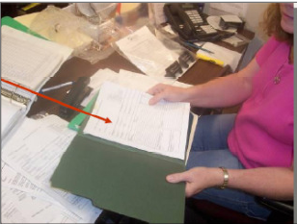
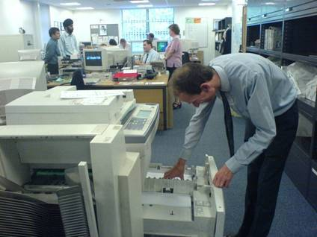
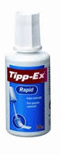
Recognizing Waste Defects
Supply Chain | Finance Processes | IT Development | Healthcare
Scrap Rework Defects Corrective actions Field failure Variation Missing parts | Data entry errors Wrong information used (e.g. rates for calculations) Pricing errors Missing information Missed specifications Lost records | Business requirements volatility Application bugs | Medication errors Wrong patients Wrong procedure Missing information Poor clinical outcomes
Information is inaccurate or incomplete
Spending time correcting defects
38
Notes:
Waste for service environment:
Transport – Any unnecessary movement of material, products, documents or information can be described as waste. This reflects on activities moving from one individual to another, within departments or between departments, which adds time to the overall process. In
the service environment, this manifests itself as tasks to be collected and delivered, physically or virtually.
Inventory - It’s the physical piles of un-cleared inboxes, list of pending enquiries or emails or time a client spends in a queue.
Motion - It is the unnecessary movement of people or resources. The physical movement of personnel from a station to another to continue a process is an example of motion. Others include the switching between computer terminals or databases, is a form of motion, which requires additional steps to be executed before a truly value-adding step can be carried out.
Waiting - It is the elapsed time between the end of a process step or activity to the beginning of another. Waiting may have a direct or indirect impact to the customer. The time spent waiting between processes results in customers having to wait for the delivery the service.
Over processing - Generically, Over-Processing means adding more work to the service than necessary, trying to exceed the customers’ requirement. This in-fact translates to adding more value to a service than what a customer is willing to pay for. These are typically caused by not clearly understanding the customer’s requirement or having to manage redundancy in process.
Over production - Over-Production is the use of capacity and capability beyond the mean of the present service or product requirement, resulting in outputs that are not delivered to customers. Over-production, in a sense, is work carried out ahead of customers’ need and
can also result is wastes as the services are performed without the clear understanding the customer’s requirement or when there is no demand from the customer.
Defects - The waste of defect is always seen when nonconformity exists. When products or services do not conform to a customer’s demand, then it’s a defect, and all effort in time, resources, materials and cost are wasted. There is a price to pay for non-conformity.
For an organization, it has produced work or service that a customer in not willing to pay for – and ultimately driving the customer to see an alternate provider for the products and services. Typically, the voice of customer is heard when a defect occurs, in the form of complaints. And many organizations engage in improving the complaints handling processes and fail to focus on the process value stream to identify where the defect occurs. Eliminating the root cause of defects presents a lasting solution to eliminating this waste.

Slide 39


Recognizing Waste Skills
Supply Chain | Finance Processes | IT Development | Healthcare
Job rotation inexistent Low level of cross-training Low level of communication between shifts No staff engagement to problem solving activities | Silos mindset Specialist skills not recognised Critical resource Training provided but new skills not applied to the work Reluctance to challenge the status quo | Limited level of cross-training-reusability of resources across different applications Sub-optimal utilization of employees and off-shoring resources | Low level of communications between shifts or between specialties Low level of cross training
The under-utilisation of our people, their knowledge and skills
39
Notes:
Waste for service environment:
Transport – Any unnecessary movement of material, products, documents or information can be described as waste. This reflects on activities moving from one individual to another, within departments or between departments, which adds time to the overall process. In
the service environment, this manifests itself as tasks to be collected and delivered, physically or virtually.
Inventory - It’s the physical piles of un-cleared inboxes, list of pending enquiries or emails or time a client spends in a queue.
Motion - It is the unnecessary movement of people or resources. The physical movement of personnel from a station to another to continue a process is an example of motion. Others include the switching between computer terminals or databases, is a form of motion, which requires additional steps to be executed before a truly value-adding step can be carried out.
Waiting - It is the elapsed time between the end of a process step or activity to the beginning of another. Waiting may have a direct or indirect impact to the customer. The time spent waiting between processes results in customers having to wait for the delivery the service.
Over processing - Generically, Over-Processing means adding more work to the service than necessary, trying to exceed the customers’ requirement. This in-fact translates to adding more value to a service than what a customer is willing to pay for. These are typically caused by not clearly understanding the customer’s requirement or having to manage redundancy in process.
Over production - Over-Production is the use of capacity and capability beyond the mean of the present service or product requirement, resulting in outputs that are not delivered to customers. Over-production, in a sense, is work carried out ahead of customers’ need and
can also result is wastes as the services are performed without the clear understanding the customer’s requirement or when there is no demand from the customer.
Defects - The waste of defect is always seen when nonconformity exists. When products or services do not conform to a customer’s demand, then it’s a defect, and all effort in time, resources, materials and cost are wasted. There is a price to pay for non-conformity.
For an organization, it has produced work or service that a customer in not willing to pay for – and ultimately driving the customer to see an alternate provider for the products and services. Typically, the voice of customer is heard when a defect occurs, in the form of complaints. And many organizations engage in improving the complaints handling processes and fail to focus on the process value stream to identify where the defect occurs. Eliminating the root cause of defects presents a lasting solution to eliminating this waste.

Slide 40
Waste Quiz
Observation: 1 of 6
After taking an order, the Customer Service Professional subsequently found that the stocks quantity was not updated. He has to cancel and recreate another order for the customer.
T : Transport
I : Inventory
M : Motion
W : Waiting
O : Over Production
O : Over Processing
D : Defect
Not Waste
40
Notes:
Waste for service environment:
Transport – Any unnecessary movement of material, products, documents or information can be described as waste. This reflects on activities moving from one individual to another, within departments or between departments, which adds time to the overall process. In
the service environment, this manifests itself as tasks to be collected and delivered, physically or virtually.
Inventory - It’s the physical piles of un-cleared inboxes, list of pending enquiries or emails or time a client spends in a queue.
Motion - It is the unnecessary movement of people or resources. The physical movement of personnel from a station to another to continue a process is an example of motion. Others include the switching between computer terminals or databases, is a form of motion, which requires additional steps to be executed before a truly value-adding step can be carried out.
Waiting - It is the elapsed time between the end of a process step or activity to the beginning of another. Waiting may have a direct or indirect impact to the customer. The time spent waiting between processes results in customers having to wait for the delivery the service.
Over processing - Generically, Over-Processing means adding more work to the service than necessary, trying to exceed the customers’ requirement. This in-fact translates to adding more value to a service than what a customer is willing to pay for. These are typically caused by not clearly understanding the customer’s requirement or having to manage redundancy in process.
Over production - Over-Production is the use of capacity and capability beyond the mean of the present service or product requirement, resulting in outputs that are not delivered to customers. Over-production, in a sense, is work carried out ahead of customers’ need and
can also result is wastes as the services are performed without the clear understanding the customer’s requirement or when there is no demand from the customer.
Defects - The waste of defect is always seen when nonconformity exists. When products or services do not conform to a customer’s demand, then it’s a defect, and all effort in time, resources, materials and cost are wasted. There is a price to pay for non-conformity.
For an organization, it has produced work or service that a customer in not willing to pay for – and ultimately driving the customer to see an alternate provider for the products and services. Typically, the voice of customer is heard when a defect occurs, in the form of complaints. And many organizations engage in improving the complaints handling processes and fail to focus on the process value stream to identify where the defect occurs. Eliminating the root cause of defects presents a lasting solution to eliminating this waste.

Slide 41
Waste Quiz
Observation: 2 of 6
A supplier delivers product. The driver sits in the truck for 20 minutes until the warehouse supervisor arrives to sign the delivery ticket.
T : Transport
I : Inventory
M : Motion
W : Waiting
O : Over Production
O : Over Processing
D : Defect
Not Waste
41
Notes:
Waste for service environment:
Transport – Any unnecessary movement of material, products, documents or information can be described as waste. This reflects on activities moving from one individual to another, within departments or between departments, which adds time to the overall process. In
the service environment, this manifests itself as tasks to be collected and delivered, physically or virtually.
Inventory - It’s the physical piles of un-cleared inboxes, list of pending enquiries or emails or time a client spends in a queue.
Motion - It is the unnecessary movement of people or resources. The physical movement of personnel from a station to another to continue a process is an example of motion. Others include the switching between computer terminals or databases, is a form of motion, which requires additional steps to be executed before a truly value-adding step can be carried out.
Waiting - It is the elapsed time between the end of a process step or activity to the beginning of another. Waiting may have a direct or indirect impact to the customer. The time spent waiting between processes results in customers having to wait for the delivery the service.
Over processing - Generically, Over-Processing means adding more work to the service than necessary, trying to exceed the customers’ requirement. This in-fact translates to adding more value to a service than what a customer is willing to pay for. These are typically caused by not clearly understanding the customer’s requirement or having to manage redundancy in process.
Over production - Over-Production is the use of capacity and capability beyond the mean of the present service or product requirement, resulting in outputs that are not delivered to customers. Over-production, in a sense, is work carried out ahead of customers’ need and
can also result is wastes as the services are performed without the clear understanding the customer’s requirement or when there is no demand from the customer.
Defects - The waste of defect is always seen when nonconformity exists. When products or services do not conform to a customer’s demand, then it’s a defect, and all effort in time, resources, materials and cost are wasted. There is a price to pay for non-conformity.
For an organization, it has produced work or service that a customer in not willing to pay for – and ultimately driving the customer to see an alternate provider for the products and services. Typically, the voice of customer is heard when a defect occurs, in the form of complaints. And many organizations engage in improving the complaints handling processes and fail to focus on the process value stream to identify where the defect occurs. Eliminating the root cause of defects presents a lasting solution to eliminating this waste.

Slide 42
Waste Quiz
Observation: 3 of 6
The administrator requests a ladder in office because the files she regularly use are placed on the top shelf of the cabinet.
T : Transport
I : Inventory
M : Motion
W : Waiting
O : Over Production
O : Over Processing
D : Defect
Not Waste
42
Notes:
Waste for service environment:
Transport – Any unnecessary movement of material, products, documents or information can be described as waste. This reflects on activities moving from one individual to another, within departments or between departments, which adds time to the overall process. In
the service environment, this manifests itself as tasks to be collected and delivered, physically or virtually.
Inventory - It’s the physical piles of un-cleared inboxes, list of pending enquiries or emails or time a client spends in a queue.
Motion - It is the unnecessary movement of people or resources. The physical movement of personnel from a station to another to continue a process is an example of motion. Others include the switching between computer terminals or databases, is a form of motion, which requires additional steps to be executed before a truly value-adding step can be carried out.
Waiting - It is the elapsed time between the end of a process step or activity to the beginning of another. Waiting may have a direct or indirect impact to the customer. The time spent waiting between processes results in customers having to wait for the delivery the service.
Over processing - Generically, Over-Processing means adding more work to the service than necessary, trying to exceed the customers’ requirement. This in-fact translates to adding more value to a service than what a customer is willing to pay for. These are typically caused by not clearly understanding the customer’s requirement or having to manage redundancy in process.
Over production - Over-Production is the use of capacity and capability beyond the mean of the present service or product requirement, resulting in outputs that are not delivered to customers. Over-production, in a sense, is work carried out ahead of customers’ need and
can also result is wastes as the services are performed without the clear understanding the customer’s requirement or when there is no demand from the customer.
Defects - The waste of defect is always seen when nonconformity exists. When products or services do not conform to a customer’s demand, then it’s a defect, and all effort in time, resources, materials and cost are wasted. There is a price to pay for non-conformity.
For an organization, it has produced work or service that a customer in not willing to pay for – and ultimately driving the customer to see an alternate provider for the products and services. Typically, the voice of customer is heard when a defect occurs, in the form of complaints. And many organizations engage in improving the complaints handling processes and fail to focus on the process value stream to identify where the defect occurs. Eliminating the root cause of defects presents a lasting solution to eliminating this waste.

Slide 43
Waste Quiz
Observation: 4 of 6
The production supervisor check that the operator enters correct cycle time information in SAP twice a day.
T : Transport
I : Inventory
M : Motion
W : Waiting
O : Over Production
O : Over Processing
D : Defect
Not Waste
43
Notes:
Waste for service environment:
Transport – Any unnecessary movement of material, products, documents or information can be described as waste. This reflects on activities moving from one individual to another, within departments or between departments, which adds time to the overall process. In
the service environment, this manifests itself as tasks to be collected and delivered, physically or virtually.
Inventory - It’s the physical piles of un-cleared inboxes, list of pending enquiries or emails or time a client spends in a queue.
Motion - It is the unnecessary movement of people or resources. The physical movement of personnel from a station to another to continue a process is an example of motion. Others include the switching between computer terminals or databases, is a form of motion, which requires additional steps to be executed before a truly value-adding step can be carried out.
Waiting - It is the elapsed time between the end of a process step or activity to the beginning of another. Waiting may have a direct or indirect impact to the customer. The time spent waiting between processes results in customers having to wait for the delivery the service.
Over processing - Generically, Over-Processing means adding more work to the service than necessary, trying to exceed the customers’ requirement. This in-fact translates to adding more value to a service than what a customer is willing to pay for. These are typically caused by not clearly understanding the customer’s requirement or having to manage redundancy in process.
Over production - Over-Production is the use of capacity and capability beyond the mean of the present service or product requirement, resulting in outputs that are not delivered to customers. Over-production, in a sense, is work carried out ahead of customers’ need and
can also result is wastes as the services are performed without the clear understanding the customer’s requirement or when there is no demand from the customer.
Defects - The waste of defect is always seen when nonconformity exists. When products or services do not conform to a customer’s demand, then it’s a defect, and all effort in time, resources, materials and cost are wasted. There is a price to pay for non-conformity.
For an organization, it has produced work or service that a customer in not willing to pay for – and ultimately driving the customer to see an alternate provider for the products and services. Typically, the voice of customer is heard when a defect occurs, in the form of complaints. And many organizations engage in improving the complaints handling processes and fail to focus on the process value stream to identify where the defect occurs. Eliminating the root cause of defects presents a lasting solution to eliminating this waste.

Slide 44
Waste Quiz
Observation: 5 of 6
The Sales Support staff adjusts the location delivery to ensure that delivery for a special order is made within the customer’s specifications.
T : Transport
I : Inventory
M : Motion
W : Waiting
O : Over Production
O : Over Processing
D : Defect
Not Waste
44
Notes:
Waste for service environment:
Transport – Any unnecessary movement of material, products, documents or information can be described as waste. This reflects on activities moving from one individual to another, within departments or between departments, which adds time to the overall process. In
the service environment, this manifests itself as tasks to be collected and delivered, physically or virtually.
Inventory - It’s the physical piles of un-cleared inboxes, list of pending enquiries or emails or time a client spends in a queue.
Motion - It is the unnecessary movement of people or resources. The physical movement of personnel from a station to another to continue a process is an example of motion. Others include the switching between computer terminals or databases, is a form of motion, which requires additional steps to be executed before a truly value-adding step can be carried out.
Waiting - It is the elapsed time between the end of a process step or activity to the beginning of another. Waiting may have a direct or indirect impact to the customer. The time spent waiting between processes results in customers having to wait for the delivery the service.
Over processing - Generically, Over-Processing means adding more work to the service than necessary, trying to exceed the customers’ requirement. This in-fact translates to adding more value to a service than what a customer is willing to pay for. These are typically caused by not clearly understanding the customer’s requirement or having to manage redundancy in process.
Over production - Over-Production is the use of capacity and capability beyond the mean of the present service or product requirement, resulting in outputs that are not delivered to customers. Over-production, in a sense, is work carried out ahead of customers’ need and
can also result is wastes as the services are performed without the clear understanding the customer’s requirement or when there is no demand from the customer.
Defects - The waste of defect is always seen when nonconformity exists. When products or services do not conform to a customer’s demand, then it’s a defect, and all effort in time, resources, materials and cost are wasted. There is a price to pay for non-conformity.
For an organization, it has produced work or service that a customer in not willing to pay for – and ultimately driving the customer to see an alternate provider for the products and services. Typically, the voice of customer is heard when a defect occurs, in the form of complaints. And many organizations engage in improving the complaints handling processes and fail to focus on the process value stream to identify where the defect occurs. Eliminating the root cause of defects presents a lasting solution to eliminating this waste.

Slide 45
Waste Quiz
Observation: 6 of 6
The team develops some new products, but is unable to sell them to the customers.
T : Transport
I : Inventory
M : Motion
W : Waiting
O : Over Production
O : Over Processing
D : Defect
Not Waste
45
Notes:
Waste for service environment:
Transport – Any unnecessary movement of material, products, documents or information can be described as waste. This reflects on activities moving from one individual to another, within departments or between departments, which adds time to the overall process. In
the service environment, this manifests itself as tasks to be collected and delivered, physically or virtually.
Inventory - It’s the physical piles of un-cleared inboxes, list of pending enquiries or emails or time a client spends in a queue.
Motion - It is the unnecessary movement of people or resources. The physical movement of personnel from a station to another to continue a process is an example of motion. Others include the switching between computer terminals or databases, is a form of motion, which requires additional steps to be executed before a truly value-adding step can be carried out.
Waiting - It is the elapsed time between the end of a process step or activity to the beginning of another. Waiting may have a direct or indirect impact to the customer. The time spent waiting between processes results in customers having to wait for the delivery the service.
Over processing - Generically, Over-Processing means adding more work to the service than necessary, trying to exceed the customers’ requirement. This in-fact translates to adding more value to a service than what a customer is willing to pay for. These are typically caused by not clearly understanding the customer’s requirement or having to manage redundancy in process.
Over production - Over-Production is the use of capacity and capability beyond the mean of the present service or product requirement, resulting in outputs that are not delivered to customers. Over-production, in a sense, is work carried out ahead of customers’ need and
can also result is wastes as the services are performed without the clear understanding the customer’s requirement or when there is no demand from the customer.
Defects - The waste of defect is always seen when nonconformity exists. When products or services do not conform to a customer’s demand, then it’s a defect, and all effort in time, resources, materials and cost are wasted. There is a price to pay for non-conformity.
For an organization, it has produced work or service that a customer in not willing to pay for – and ultimately driving the customer to see an alternate provider for the products and services. Typically, the voice of customer is heard when a defect occurs, in the form of complaints. And many organizations engage in improving the complaints handling processes and fail to focus on the process value stream to identify where the defect occurs. Eliminating the root cause of defects presents a lasting solution to eliminating this waste.

Slide 46
Removing Waste
Lean Tools to remove the root cause of the waste
What you see
What you can do (Lean tools)
Inventory at various steps of the value stream
Implement takt time and load balancing (Cycle time diagram)
People searching for tools, customer folders
Implement 5S to locate tools and folders easily
Products or services being moved lots of times between operators
Work place organisation to remove transportation
Errors being created within the value stream
Implement Mistake Proofing & Andons to prevent or highlight errors
Different operators performing the same task differently
Use of standardisation for key activities
Problems not clearly visual, high complaints routed to supervisors
Use of visual management & controls to operationally manage value stream
Notes:
Lean is all about flowing more value to the customers for less resource
Explain process takes for instance 30 days
When you look at what the application is doing you will find:
Waste examples: Waiting time, transport, rework

Slide 47
Removing Waste
Lean Tools to remove the root cause of the waste
What you see
What you can do (Lean tools)
Resources not being fully utilised
Load balancing (Heijunka)
Excessive motion as people walk to printers, faxes
Work place organisation (5S)
Comlicated forms and spreadsheets with excessive code completion
Establish reasons for use, mistake proof coding and remove duplication
More products or service material produced creating large inventory
Implement a kanban (pull) system
Data being input into multiple screens
Set up automated interfaces to input once and use many
Services or products on hold whilst waiting for information
Use 5S and visual management to highlight.
Notes:
Lean is all about flowing more value to the customers for less resource
Explain process takes for instance 30 days
When you look at what the application is doing you will find:
Waste examples: Waiting time, transport, rework

Slide 48
Identifying Waste
Removing waste can deliver more customer value using less resources
Suppliers
Customers
Before Lean Six Sigma project
Inputs
Outputs
A service value stream: e.g. processing an application
day 1
End to end lead time (LT)
day 30
5 -10%
5 - 10%
80 - 90%
Customer value-add
Traditional improvement activities concentrate here
Business value-add
LSS activities need to challenge old business reasons for these activities
Non-value add
LSS activities concentrate here
After Lean Six Sigma project
The bottom line:
Better customer service costs less, not more!
processing an application
day 1
Lead time (LT)
day 8
Notes:
Lean is all about flowing more value to the customers for less resource
Explain process takes for instance 30 days
When you look at what the application is doing you will find:
Waste examples: Waiting time, transport, rework

Slide 49

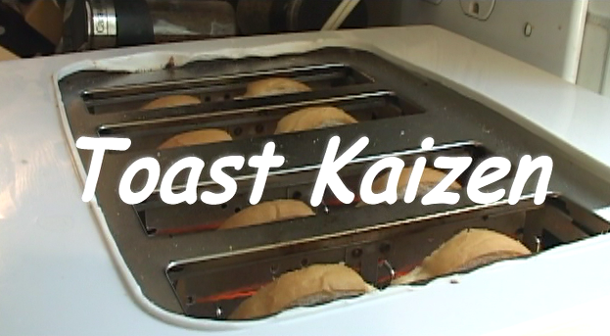
Recognizing Waste There are 8 different types of waste in a process (TIMWOODS)
49
Notes:
Waste for service environment:
Transport – Any unnecessary movement of material, products, documents or information can be described as waste. This reflects on activities moving from one individual to another, within departments or between departments, which adds time to the overall process. In
the service environment, this manifests itself as tasks to be collected and delivered, physically or virtually.
Inventory - It’s the physical piles of un-cleared inboxes, list of pending enquiries or emails or time a client spends in a queue.
Motion - It is the unnecessary movement of people or resources. The physical movement of personnel from a station to another to continue a process is an example of motion. Others include the switching between computer terminals or databases, is a form of motion, which requires additional steps to be executed before a truly value-adding step can be carried out.
Waiting - It is the elapsed time between the end of a process step or activity to the beginning of another. Waiting may have a direct or indirect impact to the customer. The time spent waiting between processes results in customers having to wait for the delivery the service.
Over processing - Generically, Over-Processing means adding more work to the service than necessary, trying to exceed the customers’ requirement. This in-fact translates to adding more value to a service than what a customer is willing to pay for. These are typically caused by not clearly understanding the customer’s requirement or having to manage redundancy in process.
Over production - Over-Production is the use of capacity and capability beyond the mean of the present service or product requirement, resulting in outputs that are not delivered to customers. Over-production, in a sense, is work carried out ahead of customers’ need and
can also result is wastes as the services are performed without the clear understanding the customer’s requirement or when there is no demand from the customer.
Defects - The waste of defect is always seen when nonconformity exists. When products or services do not conform to a customer’s demand, then it’s a defect, and all effort in time, resources, materials and cost are wasted. There is a price to pay for non-conformity.
For an organization, it has produced work or service that a customer in not willing to pay for – and ultimately driving the customer to see an alternate provider for the products and services. Typically, the voice of customer is heard when a defect occurs, in the form of complaints. And many organizations engage in improving the complaints handling processes and fail to focus on the process value stream to identify where the defect occurs. Eliminating the root cause of defects presents a lasting solution to eliminating this waste.

Slide 50

Identify “Just do it!” activities Sometimes there are obvious changes that you can implement straight away
Identifying “Just do it” Improvements
Examples
A “Just do it” is the outcome of a focused activity or set of activities that can be quickly executed and that bring rapid, observable benefits to a process or part of a process.
Stop an activity – e.g. sending unnecessary post; rationalising call scripts; duplicating referrals
Defining and communicating new activity – e.g. articulating RFI upfront; batch and delivery changes
Utilise existing technology – e.g. utilising excel and lotus applications and pdf agreement forms
“Just do it” typically…
Have low levels of impact to technology
Have low levels of impact to organisational design
Carry low levels of implementation risk
“Just do it” are…
Easy to implement
Easy to reverse
Low cost or effort
Low risk
Meaningful impact performance or morale

Slide 51

Simulation Round 2
Back in your simulation rooms, as a group identify 3 “Just do it” that you could implement to improve your process before we run the simulation again. As you will find in real life business scenarios, your “Just do it” changes are constrained:
- No change to process layout
- No change in order of roles
- No customer feedback
Once you have identified your changes create a SIPOC for your new process that incorporates these improvements
30 minutes

Slide 52

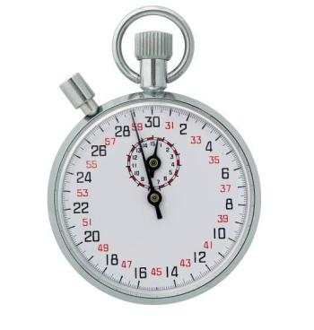
Simulation Round 2 Implement your “Just do it” and run Round 2
Run Round 2 for 12 minutes

Slide 53

Simulation Round 2 Feedback and post round summary
Feedback - How did it go?
Idle time
Morale during the process

Slide 54
Agenda Day 2 - Current State 1, Current State 2
Section 1 | Quiz from Day 1 Introduction to Current State 1
Section 2 | Voice of Customer (VOC) Critical to Quality (CTQ) Customer demand analysis
Section 3 | Value Flow and Identifying Waste Identify “Just do it” activities Simulation Round 2 Record and review simulation performance
Section 4 | Introduction to Current State 2 Seeing is Believing Value Stream Mapping
Section 5 | Exercise – Value Stream Mapping Exercise – Identifying Value Add / Non Value Add Steps
Section 6 | Typical Workshop Agenda Day 2 Review & Wrap up

Slide 55
Current State 2 What are the main objectives of the second Current State workshop?
Mobilisation
Current State
Future State
Implement improvements
Week -2
M | T |  | T | F
Week 1
M | T | W | T | F
Week 2
M | T | W | T | F
Week 3
M | T | W | T | F
Week 4
M | T | W | T | F
Week 5 12
M | T |  | T | F
M
CS1
CS2 – Map
FS1
FS2
Work pilot
M
Mobilisation: Kick-off, confirm scope, SIPOC, team – complete project charter
½ day
CS1
Current State 1: Lean Simulation, VoC, value stream flow,
plan for ‘seeing is believing’
1 day
CS2
Current State 2: Seeing is believing, As-is value stream map
3 days
FS1
Future State 1: Value and waste analysis, blue sky vision, to-be value stream map
2 days
FS2
Future State 2: Work package definition and charters, prioritisation and high level plan
2 days
WP
Work Pilot: Test the changes and refine the design before roll-out
8 weeks

Slide 56
The Deloitte 5 Workshop Approach Where does today fit in the 5 Workshop approach?
M - Mobilisation Workshop
CS1 - As-Is High level Workshop
CS2 - As-Is Detail Workshop
FS1 - Future State Workshop
FS2 - Implementation Planning Workshop
WP - Running the
Work Pilot
Outputs
Project Kick-off
Finalised Scope
High-level process
Team Selected
High level plan agreed
Customer requirements
Plan interviews and current state mapping
Current State map
Report back to key stakeholders
Future State map
Report back to key stakeholders
Implementation plan & charters
Final Report back
Rapid execution of the quick hits and impro-vement opportunities identified
Confirm expected benefits
Initial identification of the quick wins to be refined and designed, ready to be executed
Key Activities
Lean Awareness
Validation of end to end process scope
Value tree analysis
Refine charter
Confirm data requirements
Identify design boundaries
Lean education by “doing” in a practical environment - team building
Review charter, SIPOC and demand
Understand who the customers are (VOC) and their requirements
Value Stream Flow
Plan for ‘seeing is believing’
Seeing is Believing - Walk the process to understand what really happens, how long it takes, and what the key issues are
Construct the current end to end value stream map
Conduct value and waste analysis; identify what is preventing the value to flow
Define blue sky vision and agree future state lean design principles
Map the future state
Highlight benefits
Identify the implementation work packages and draft charters
Prioritise work packages
Define a high-level implementation plan
Agree pilot content
Agree governance and gain stakeholder buy-in
Test & refine the new streamlined process in a safe environment
Implement visual management
Develop standardised operating procedures
Measure new KPIs
Up-date the front line knowledge base,
Plan transfer to BAU
Tools and techniques
Problem scoping
Identify process owners, suppliers, customers (SIPOC)
Value Tree
Data collection
Project Charter
Lean simulation game
VOC data & CTQ
Understand demand - Mississippi Chart
Runners, Repeaters and Strangers
Value tree
Seeing is Believing
Value stream mapping
Baseline Metrics
7 wastes analysis
Root cause analysis and problem-solving
5S analysis (work place management)
Lean design principles
Pull systems and one piece flow
Mistake proofing
Andon system
Takt time
Cycle time diagram
Load balancing
Leveling heijunka
Improvement Work Packages charters
Ease versus Impact assessment
Gantt chart
Work pilot mission
5S environment
Standard Work
Decision Trees
Skill matrix
KPI & Run charts
Control charts
Quality matrix, FMEA
Problem solving & 8D
Notes:
Version

Slide 57

Seeing Is Believing You’ll only know what’s really happening, if you go and see for yourself
One of the key principles of Lean is to “go see for yourself”
This means visiting the “shop floor” and finding out what really happens
During shop floor visits you can observe:
People: see the morale of the team, and how people work together
Processes: see the real flow of items through a process. This can be physical “things” or information and data
Tools: observe how tools, systems and machines are used in the office / production
What’s important is that you prepare for the visit, understand and record what you see:
Value add / non-value add activities
Wastes / issues / “Just do it” opportunities
Good practices to replicate in other areas
Video: Card trick - www.youtube.com/watch?v=voAntzB7EwE

Slide 58
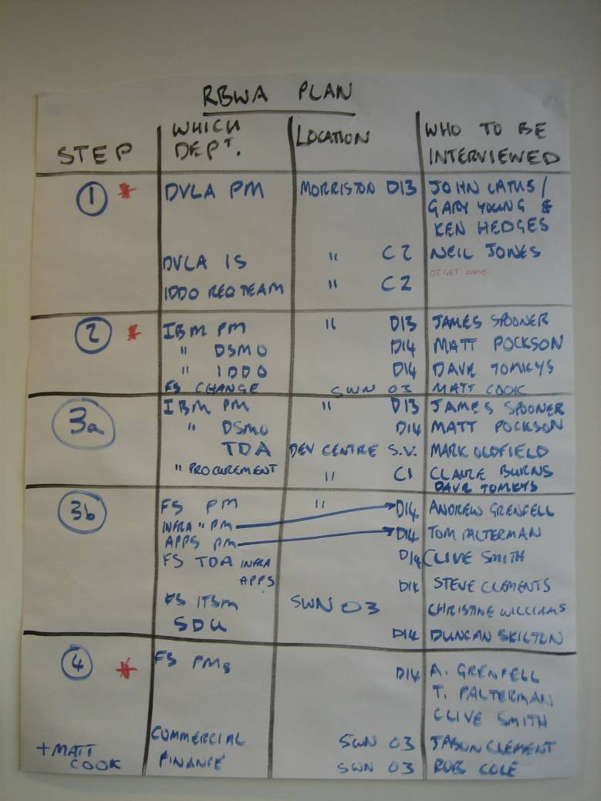
Plan for ‘Seeing is Believing’ Removing waste can deliver more customer value using less resources
Objective: Prepare for the observation in the field (to be done in CS1)
Key questions:
Do we all agree on the key process steps?
Which location(s) shall we go to see the Value Stream?
Who are the people we will interview?
What will the roles be?
Team work:
Confirm the “product” to be visited
Agree on key steps to go and see
Agree on the questionnaire (see VSM template to fill in)
Identify the roles of the team members for the site visit (who asks questions / takes notes…)
Plan and schedule the visit
Notes:
On a flip chart list each area to be visited, who will arrange the visit and when this is planned for.

Slide 59
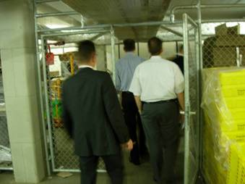
Preparing with the team for ‘Seeing is Believing’ Adopting the right mindset and behaviour
Remember
Behave like a “guest” at the workplace
Demonstrate Lean behaviors
Demonstrate positive body language
Listen attentively/empathically
Reassure the teams that they are doing a good job
If we see an issue remember “it’s the process not the people”
Seek first to “understand” not to “Solve”
The purpose of the Waste Walk is not to leave a “to do” list behind
“We need to be hard on the problem and easy on the people”
Notes:
On a flip chart list each area to be visited, who will arrange the visit and when this is planned for.

Slide 60
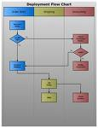
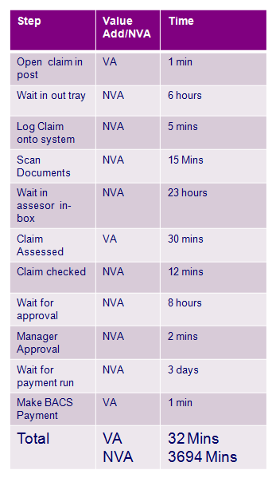
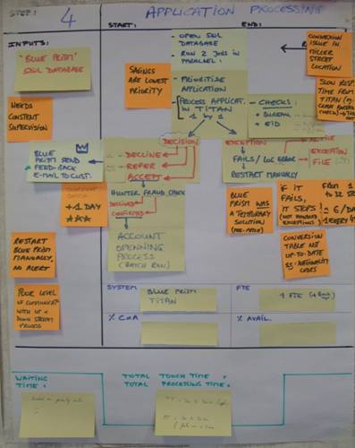
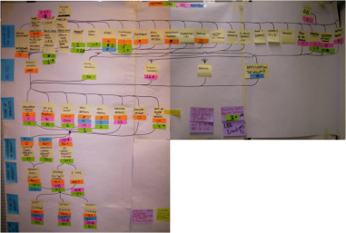
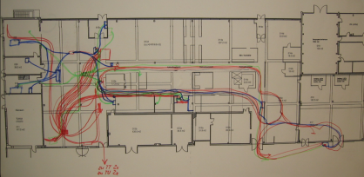
Seeing Is Believing – Different Techniques There are different techniques to use when conducting “Seeing is Believing”
Two ways to “see for yourself” that allow you to visualise and analyse your findings
“Go to the Gemba” Waste Walks
Process “stapling”
Walk the process
Which of the 8 wastes do you observe?
Where in the process do you observe them?
What is the impact they have on lead time, team morale, performance?
“Staple” yourself to the item going through the process
What happens to you? Where do you hang around for a long time? Do you get moved form place to place with no value being added?
Take pictures on the way to record and demonstrate
1
Functional Process Map
5
Value Add Analysis
2
Value Stream Map
3
Mississippi diagram
4
Spaghetti Chart

Slide 61
What is a Cross Functional Process Map ?
1
Why use it:
A graphical representation of work process steps showing inputs, outputs, decisions and tasks in sequence including handoffs across functions
Provides a view of work as it is performed across functions or area of responsibility
When use it:
To document the “as-is” or "to-be" process
To formally keep a documented process with tools like Visio, MEGA or ARIS
Example
Symbol | Interpretation
 | Process step
 | Process beginning or end point
 | Database or system
 | Decision Point (AND or OR)
 | Connector
 | External Process (e.g., outside the organization)
 | Continuation into next page
The process is organized in swim lanes:
61

Slide 62
What is Value Stream Mapping?
2
Value Stream Mapping (VSM) is a high level process analysis tool that helps you see and understand the physical flow of material and information as a product/service makes its way through the value stream.
Taking a value stream perspective means working on the end to end process, not just individual processes, and improving the whole, not just optimizing the parts.
A value stream includes all the actions (both value added and non-value added) currently required to produce the product/service through the main flows essential to every product/service.
Suppliers
Transformation Processes
Customer
Value Stream
62

Slide 63
What’s the difference between VSM and Cross Functional Process Map ?
2
Value Stream Maps focus on product/service
Value Stream Maps link work centres by movements, signals and information
Value Stream Maps can be used to split up lead time in value add and non value add
Value Stream Maps identify sources of waste:
Transport time
Queuing time
Inventory
Changeover time
Process Maps focus on activities, decisions and handovers
Process Maps link activities via inputs and outputs
Process Maps can be used to split steps into value add and non value add
Process Maps can be used to keep the process documented
63

Slide 64
Value Stream Mapping Make sure you’re ready to capture the right information
Filling in a structured template will ensure that you capture all the necessary information about the process, such as:
Step Name
Detail of the process steps: capture all the sequential activities performed within the step
Process time of each activity
Leadtime of the step
STEP Name
Process steps
Time
Total
Activities 1
Activities 2
…
Performance metrics
E.g. Min / Max elpase time
64

Slide 65
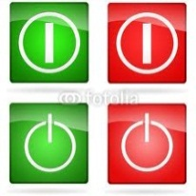





Value Stream Mapping Make sure you’re ready to capture the right information
Completing the step with additional information covering process, people & systems:
Start & End points
Demand variability
Prioritization method (e.g. FIFO)
Inputs
Outputs
Backlog and inventory
Delays and waiting times
FTEs on the process step
Tools & systems used (e.g. xls files, uptime of the equipment…)
Defects (e.g. errors occurring at this stage of the proccess)
Rework activities undertaken
STEP: #
STEP Name
Start
Demand
Tools & Systems
End
Priority order
Process steps
Time
Total
Defects
FIFO
Activities 1
Activities 2
…
Inputs
Outputs
Waiting
Resources
Performance metrics
E.g. Min / Max elpase time

Slide 66
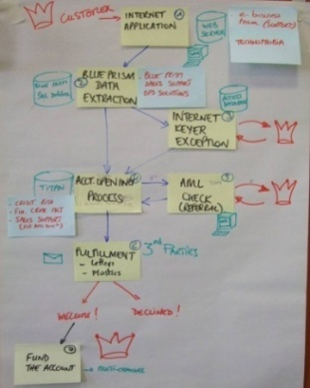


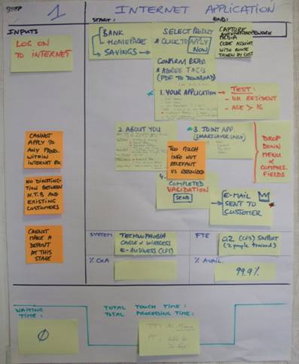
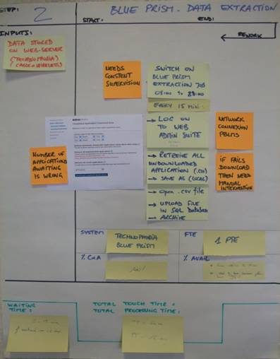
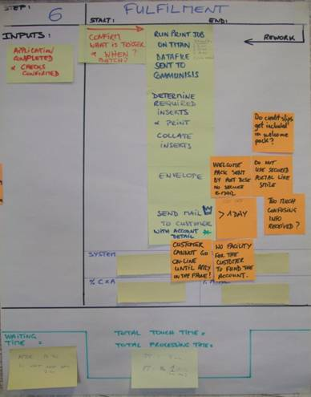
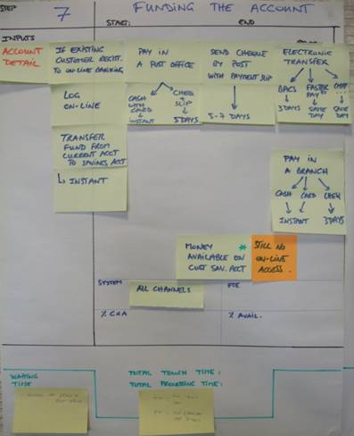

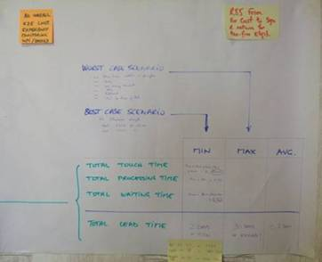

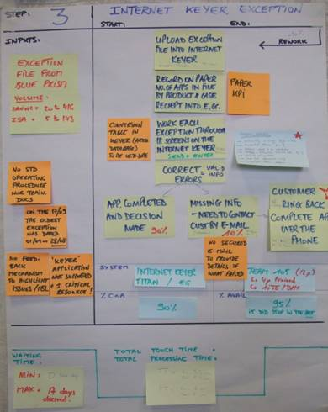
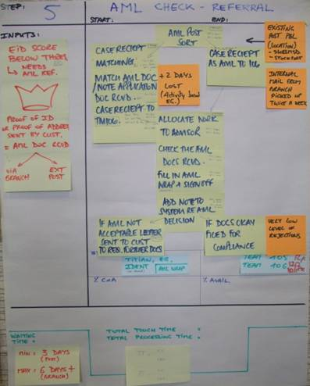
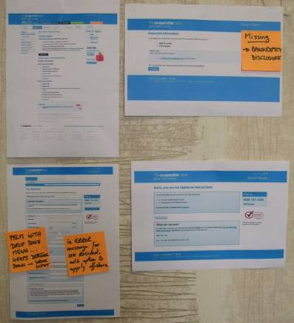
Value Stream Mapping Mapping out the full value stream helps us to visualise the whole process
0
3
5
The Value Stream Flow shows the process flow for each of the process steps within the SIPOC accounting for parallel steps or alternative steps that may be taken within a process
List all process attributes:
Name of the step
Role performing the step
Individual tasks & processing time
System used
Number of operators
Lean metrics e.g. Processing time, in-process lead time, % Complete & Accurate , % Availability, etc
Rework % and additional rework metrics
Draw all communications that occur within the Value Stream.
You can distinguish phone calls, e-mails, electronic transactions…
A
B
C
D
2
E
Draw all process steps farthest downstream
F
1
Customer
G
Draw the external (or internal) customer and the supplier (if the supplier is different from the customer) and list their requirements
Customer
letter
7
Best case scenario is 2 days and 15min
7
Additional info
Complete the map with any other data such issues, notes, and anticipate the waste analysis
6
Draw push or pull icons to identify the type of workflow
4
List inputs/outputs to the process steps, draw queue times between processes and add up the overall leadtime & cycle time
= Issues
Customer

Slide 67
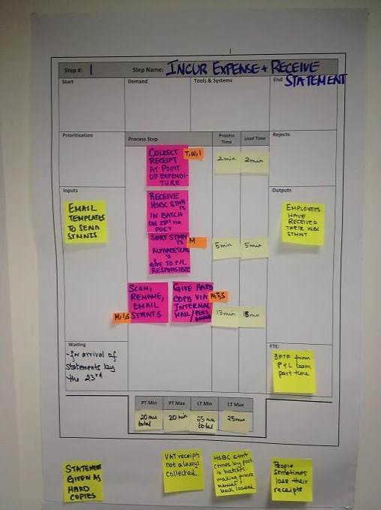
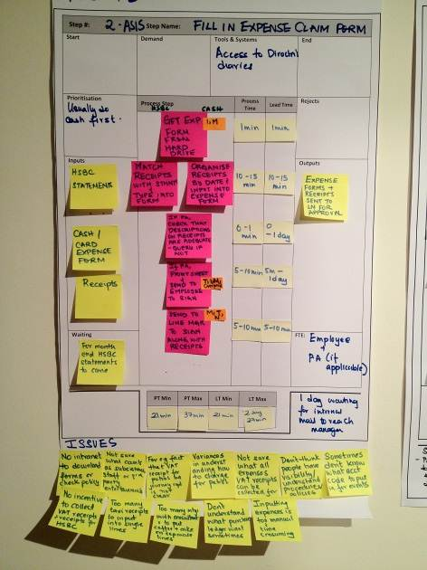
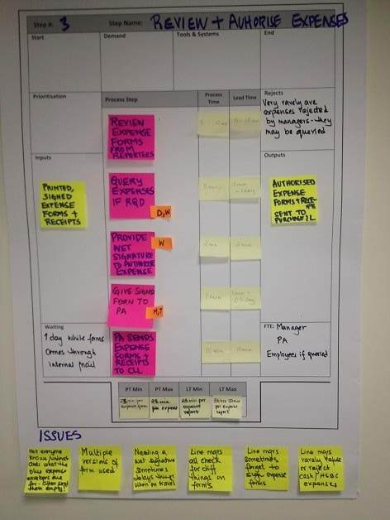
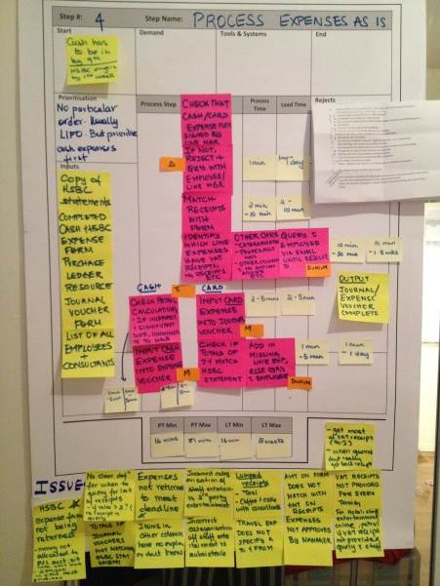
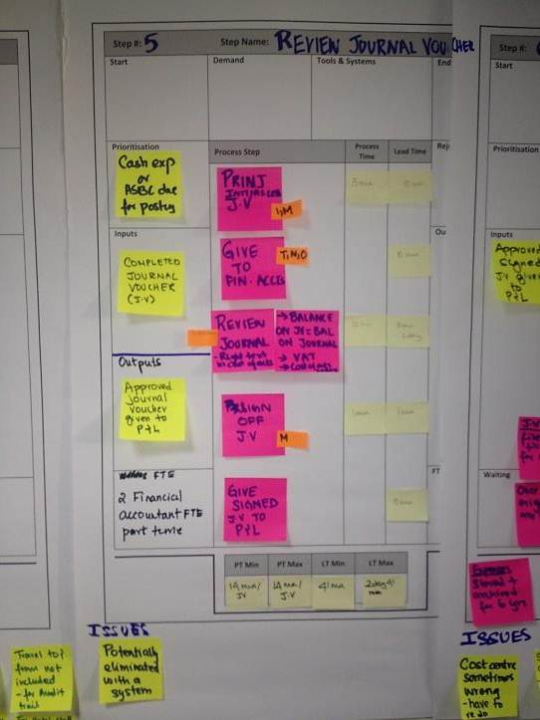
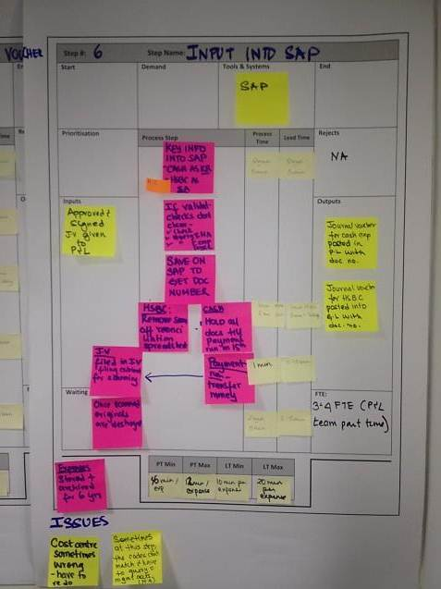
Mapping the Current State of the T&E process
Extract from
the report
The Value Stream Mapping (VSM) exercise helped the team see the physical flow of material and information as the cash/card expense form makes its way through the value stream
No incentive to
collect receipts
for card
expenses
Exp forms &
receipts travel
via post
to managers
& then to P&C
Duplication
of the data
entries – on form,
on journal
voucher, into
SAP
Payment
run
processed
once a month
Policy unclear
not easily
accessible
electronically
Multiple errors,
incomplete info
on expense
forms
E2E Process
Time
Min = 1hr 40 m
Max = 2hr 42 m
E2E Lead Time
Min= 2 hr 20 m
Max = ~3 weeks
Most amount of errors in Step 4 are a result of actions in Step 1 and 2
The process time shows how much “touch time”(end to end time spent actually doing stuff) is spent per expense (the difference between max and min being primarily due to rework and corrections required
The lead time shows how much time the whole expense process in scope takes. The difference between process time and lead time is primarily due to waiting times. The difference between the LT max and min is primarily because of the unpredictability of the process
67
= Process
= Process information (Issues, Process & Lead times, I/O)
Notes:
Right from the start You were a thief You stole my heart And I your willing victim I let you see the parts of me That weren't all that pretty And with every touch you fixed them Now you've been talking in your sleep, oh, oh Things you never say to me, oh, oh Tell me that you've had enough Of our love, our love Just give me a reason Just a little bit's enough Just a second we're not broken just bent And we can learn to love again It's in the stars It's been written in the scars on our hearts We're not broken just bent And we can learn to love again I'm sorry I don't understand Where all of this is coming from I thought that we were fine (Oh, we had everything) Your head is running wild again My dear we still have everythin' And it's all in your mind (Yeah but this is happenin') You've been havin' real bad dreams, oh, oh You used to lie so close to me, oh, oh There's nothing more than empty sheets Between our love, our love Oh, our love, our love Just give me a reason Just a little bit's enough Just a second we're not broken just bent And we can learn to love again I never stopped You're still written in the scars on my heart You're not broken just bent And we can learn to love again Oh, tear ducts and rust I'll fix it for us We're collecting dust But our love's enough You're holding it in You're pouring a drink No nothing is as bad as it seems We'll come clean Just give me a reason Just a little bit's enough Just a second we're not broken just bent And we can learn to love again It's in the stars It's been written in the scars on our hearts That we're not broken just bent And we can learn to love again Just give me a reason Just a little bit's enough Just a second we're not broken just bent And we can learn to love again It's in the stars It's been written in the scars on our hearts That we're not broken just bent And we can learn to love again Oh, we can learn to love again Oh, we can learn to love again Oh, oh, that we're not broken just bent And we can learn to love again

Slide 68

Uncovering key findings and issues
Extract from
the report
Identifying value-adding activities : Our aim was to eliminate steps which do not directly contribute to creating customer. We started with the process step where the maximum pain was felt – the expense processing step
Issues identified in the expense processing stage
The same Information is transferred from the expense form to the journal voucher and then into SAP.
Using high level estimates of the time taken for individual activities, expense processing should take a maximum of 16 m. Instead it takes up to 51 m per expense, due to the time spent on rework. This rework was primarily due to missing/incorrect information filled in by the employee on the expense form. The following errors were identified as common:
Inadequate description of items in the “other” column
Account codes missing for items in the other column resulting in an escalation to management accounts
Lunches/dinners not being correctly categorised as subsistence, staff entertainment, customer entertainment etc
Incomplete expense information provided – for e.g. no names provided for customer/staff entertainment; not providing the origin and destination for travel expenses
Not splitting out travel between the UK and overseas
Amounts on expense form do not tally with receipts
Totals on the HSBC expense form not matching the totals on the HSBC card statement
In addition, there a number of issues which are due to non compliance to Chanel’s expenses policy:
Expenses not being returned to P&L deadlines to allow the P&L team to smoothen their work load
Cash/Card expense forms submitted to P&L without evidence of approval by line managers
Petrol equation not always done on cash expenses to deduct private mileage
VAT receipts not provided or absence of any receipt altogether
68

Slide 69

Uncovering key findings and issues
Extract from
the report
On analysis, all the issues and pain felt by the Purchase Ledger team tied back in some way right to the beginning of the process at the point of incurrence and logging of expenses.
Expenses Form
The expense form is not designed to conduct certain basic validation checks at the point of entry.
The expense form doesn’t prompt for required information – for e.g. account codes, name of people entertained , the to and from of travel – people are just expected to know the process and follow it.
Manually typing in multiple taxi receipts is time consuming and non value adding in the eyes of employees, so it is often easier to input them all in the same row.
A single line single expense rule becomes difficult to follow for certain stakeholders – for e.g. the area managers recording their consultancy meeting expenses for coffee and cake. They might have on average 5 of these a day and so to fill these in separately would be too time consuming.
The expenses form is not protected so calculations/formulae can be changed in the form resulting in mistakes in the petrol calculation to deduct private mileage.
The “other” column in the expenses form is a catch all column to cover a range of expenses – the employee is expected to follow the process of inputting adequate narrative, but they don’t always understand what is “adequate”.
Expenses Policy
The lack of an intranet or a Chanel shared drive means that the expense policy and form is not quickly accessible.
Employee uncertainty around what counts as subsistence, customer or staff entertainment – for e.g. entertaining of Chanel US staff mostly coded as staff entertainment instead of 3rd party entertainment.
The policy on petrol and mileage is not clear and people interpret and use it varyingly with no overarching control.
There is no incentive for the employees to collect VAT receipts for card payments which are automatically paid for by Chanel. Given the manual nature of the process, it is not feasible to collect data to monitor trends and target regular offenders.
69
Notes:
The general perception is that while there is an expenses policy, anything goes because Chanel is not a “poor” business and is not looking to cut costs

Slide 70

The Value Stream Map – Manufacturing example from “Learning To See”
Value Stream Mapping (VSM) is a high level process analysis tool that helps you see and understand the physical flow of material and information as a product makes its way through the value stream. It is sometimes called a MIFA: Material and Information Flow Analysis
Version v1.2 | Date 14/07/09

Slide 71
The Value Stream Map explained – Standard Symbols (Manufacturing)
CT = cycle time
ABC
Adhesives
Outside Sources
CO =changeover
Typical Data Box
Batch = # units
Tues &
Thurs
Truck Shipment
Avail = hrs/day
Uptime = % up
VA Time
Process time summary
PUSH Arrow
NVA Time
PULL Arrow
Lightning Burst (Opportunity)
Finished Goods to Customer
Electronic Information Flow
“Go See” Scheduling
Manual Information Flow
Signal Kanban
Weekly Schedule
Schedule
Buffer or Safety Stock
Withdrawal Kanban
Production Kanban
Operator
300 pieces
1 day
Kanban Arriving in Batches
First-In-First-Out
Sequence Flow
FIFO
Supermarket
Kanban Post
I
Amount of inventory
OXOX
Load Leveling
or
I
Version v1.2 | Date 14/07/09

Slide 72
Current State of a supply chain process
Extract from
the report
72
Notes:
Right from the start You were a thief You stole my heart And I your willing victim I let you see the parts of me That weren't all that pretty And with every touch you fixed them Now you've been talking in your sleep, oh, oh Things you never say to me, oh, oh Tell me that you've had enough Of our love, our love Just give me a reason Just a little bit's enough Just a second we're not broken just bent And we can learn to love again It's in the stars It's been written in the scars on our hearts We're not broken just bent And we can learn to love again I'm sorry I don't understand Where all of this is coming from I thought that we were fine (Oh, we had everything) Your head is running wild again My dear we still have everythin' And it's all in your mind (Yeah but this is happenin') You've been havin' real bad dreams, oh, oh You used to lie so close to me, oh, oh There's nothing more than empty sheets Between our love, our love Oh, our love, our love Just give me a reason Just a little bit's enough Just a second we're not broken just bent And we can learn to love again I never stopped You're still written in the scars on my heart You're not broken just bent And we can learn to love again Oh, tear ducts and rust I'll fix it for us We're collecting dust But our love's enough You're holding it in You're pouring a drink No nothing is as bad as it seems We'll come clean Just give me a reason Just a little bit's enough Just a second we're not broken just bent And we can learn to love again It's in the stars It's been written in the scars on our hearts That we're not broken just bent And we can learn to love again Just give me a reason Just a little bit's enough Just a second we're not broken just bent And we can learn to love again It's in the stars It's been written in the scars on our hearts That we're not broken just bent And we can learn to love again Oh, we can learn to love again Oh, we can learn to love again Oh, oh, that we're not broken just bent And we can learn to love again

Slide 73


Current State of a supply chain process
Extract from
the report
Identification of the wastes in the process
Areas
Cross-company Gaps
5
9
Inventory
1
Unquestioned use of buffer stocks
Uncontrolled lead times at EVWS
Non-visibility of EVWS’s daily production scheduling
High transport costs on peak delivery days
Fluctuating number of packaging items per pallet
Unnecessary constraint of the footbridge height
Inefficiencies with the EDI process
Unnecessary cross strips around pallets
8
Waiting
4
5
1
4
6
Transport
7
6
8
7
10
1
Over- processing
9
10
73
Notes:
Right from the start You were a thief You stole my heart And I your willing victim I let you see the parts of me That weren't all that pretty And with every touch you fixed them Now you've been talking in your sleep, oh, oh Things you never say to me, oh, oh Tell me that you've had enough Of our love, our love Just give me a reason Just a little bit's enough Just a second we're not broken just bent And we can learn to love again It's in the stars It's been written in the scars on our hearts We're not broken just bent And we can learn to love again I'm sorry I don't understand Where all of this is coming from I thought that we were fine (Oh, we had everything) Your head is running wild again My dear we still have everythin' And it's all in your mind (Yeah but this is happenin') You've been havin' real bad dreams, oh, oh You used to lie so close to me, oh, oh There's nothing more than empty sheets Between our love, our love Oh, our love, our love Just give me a reason Just a little bit's enough Just a second we're not broken just bent And we can learn to love again I never stopped You're still written in the scars on my heart You're not broken just bent And we can learn to love again Oh, tear ducts and rust I'll fix it for us We're collecting dust But our love's enough You're holding it in You're pouring a drink No nothing is as bad as it seems We'll come clean Just give me a reason Just a little bit's enough Just a second we're not broken just bent And we can learn to love again It's in the stars It's been written in the scars on our hearts That we're not broken just bent And we can learn to love again Just give me a reason Just a little bit's enough Just a second we're not broken just bent And we can learn to love again It's in the stars It's been written in the scars on our hearts That we're not broken just bent And we can learn to love again Oh, we can learn to love again Oh, we can learn to love again Oh, oh, that we're not broken just bent And we can learn to love again

Slide 74
Current State of a supply chain process
Extract from
the report
Identification of the solutions to address the root causes
Areas
Gaps
Initiatives and their Rationales
Inventory
Unquestioned use of buffer stocks
EVWS and IP carry high levels of buffer stocks. IP barely consumes it
A
Optimise buffer stocks
Lower inventory levels will be carried
Unmanaged top-layer fluctuations of inventory
A significant part of IP’s internal storage area is unutilised most of the time throughout the year
B
Make inventory management dynamic
Additional external storage area will only be used during high peaks of inventory consumption
High €€€
Under-utilised inventory storage area
The occupancy rate of IP’s internal storage area approximates 75%
C
Optimise inventory occupancy rate
The optimised occupancy rate will be estimated, which will free up pallet spaces
Waiting
Uncontrolled lead times at EVWS
Total lead time between the receiving of pallets and their consumption is not tracked at EVWS
D
Towards JIT
Material will flow more smoothly and as wanted with new tracking systems
Non-visibility of EVWS’s production scheduling
Cardboard gross requirements are clustered and not communicated as they are needed to suppliers
E
Stagger gross requirements on a daily basis
Needs will be more specifically communicated, to smooth supplies
Low €
(1)
High transport costs on peak delivery days
Extensive variations in the daily delivery pattern to EVWS entails high transport costs during peak delivery days
E
Smooth deliveries thanks to staggered gross requirements
IP will no longer need to send more than 3 trucks per day , except for emergency
Transport
(2)
Fluctuating number of packaging items / pallet
Heights of pallets for the different packaging items do not logically match with the associated paper compositions
F
Optimise palletisation to better fill pallets
A review of how palletisation is calculated will lead to increased packaging items per pallet to EVWS
Medium €€
Unnecessary constraint of the footbridge height
The number of packaging items per pallet is restricted by the footbridge height above the conveyor
G
Increase the height between the conveyor and the footbridge
A conveyor will be installed with a higher footbridge during the reorganisation scheme in 2014-2015
Over- processing
Inefficiencies with the EDI process
Creation of POs is done manually while not adding value
H
Automate Purchase order creations
An IT add-on will save valuable time to Procurement employees
Unnecessary cross strips around pallets
Pallets could be strapped with 2 parallel strips instead of 4 cross strips
I
IP will still secure the pallets with only 2 parallel strips
Low €
74
Notes:
Right from the start You were a thief You stole my heart And I your willing victim I let you see the parts of me That weren't all that pretty And with every touch you fixed them Now you've been talking in your sleep, oh, oh Things you never say to me, oh, oh Tell me that you've had enough Of our love, our love Just give me a reason Just a little bit's enough Just a second we're not broken just bent And we can learn to love again It's in the stars It's been written in the scars on our hearts We're not broken just bent And we can learn to love again I'm sorry I don't understand Where all of this is coming from I thought that we were fine (Oh, we had everything) Your head is running wild again My dear we still have everythin' And it's all in your mind (Yeah but this is happenin') You've been havin' real bad dreams, oh, oh You used to lie so close to me, oh, oh There's nothing more than empty sheets Between our love, our love Oh, our love, our love Just give me a reason Just a little bit's enough Just a second we're not broken just bent And we can learn to love again I never stopped You're still written in the scars on my heart You're not broken just bent And we can learn to love again Oh, tear ducts and rust I'll fix it for us We're collecting dust But our love's enough You're holding it in You're pouring a drink No nothing is as bad as it seems We'll come clean Just give me a reason Just a little bit's enough Just a second we're not broken just bent And we can learn to love again It's in the stars It's been written in the scars on our hearts That we're not broken just bent And we can learn to love again Just give me a reason Just a little bit's enough Just a second we're not broken just bent And we can learn to love again It's in the stars It's been written in the scars on our hearts That we're not broken just bent And we can learn to love again Oh, we can learn to love again Oh, we can learn to love again Oh, oh, that we're not broken just bent And we can learn to love again

Slide 75
Eliminating Waste in the Value Stream Before we can eliminate the waste we need to see it
To begin to develop a high performance process, there are 3 steps to follow:
Step 1 (day 2)
Step 2 (day 2)
Step 3 (day 3)
Use the Value Stream map from Current State
Identify and visualise the activities in the process that add value
Identify and visualise the activities in the process that don’t add value. These activities are either waste, or necessary non-value adding activities. Our goal is to minimise or eliminate these.
Understand the root cause of the issues within the process. This is how we will know we are addressing the problem rather than the symptom.

Slide 76
Identifying Value-Adding Activities Our aim is to eliminate costs that do not contribute to customer value
Value Add (VA) | Tasks performed during the production of a product or service that increases its value to the customer. | Is the customer willing to pay for the output? Is the input transformed in some way? Is the task completed right first time?
Business value add | Activities that add no value from the customer’s perspective but are required in order to operate the business. | Is this task required by law or regulation? Does this task reduce financial risk? Does this task ensure staff are fully trained and able to undertake the role required?
Non-Value Add (NVA) | NVA is everything else! If the customer knew we were doing this would they ask us. | To stop in order to lower our sales price or improve our margin? Can I eliminate or reduce this activity? What would happen if I didn’t do this activity?
Notes:
Feedback:
Purchasing could be value-add
Might be better placed after ‘what is value added slide’
Do we need to define ‘customer’ before going into value add stuff? Also define requirements
Too much info on slide – make lists more interesting
Too many words – maybe should be moved?

Slide 77
Identifying Value-Adding Activities Identify the areas that add value to the process
1
2
Indicate on the corner of each activity in the value stream what type of value is delivered by the step.
From the “Seeing is Believing” show on the Value Stream Map the waste next to the activity where it was observed.
Does the waste occur every time a service or product flows through the value stream?
Are there specific attributes to the product or service that cause the waste to occur?
Are there unique attributes to the resource performing the activity that results in a waste occurring?
Value Add
Business value add
Non Value Add

Slide 78

Identifying Value-Adding Activities Identify the areas that add value to the process
Hot Tips
If it appears that an activity contains both VA and NVA elements, it may be documented at too high a level.
➔ Consider whether to drill down further into the step based on what the potential impact may be, by looking at the volumes flowing through the step and the amount of waste in it.
Walk through only the value add post its and check whether the product or service can still be delivered
Demand data from the Mississippi chart may help identify specific product or service attributes that may be a contributor to waste, especially failure demand
Count the waste in a measure that matters – e.g. Transportation can measured in distance, over-processing can be measured in ‘mouse clicks’

Slide 79
Agenda Day 2 - Current State 1, Current State 2
Section 1 | Quiz from Day 1 Introduction to Current State 1
Section 2 | Voice of Customer (VOC) Critical to Quality (CTQ) Customer demand analysis
Section 3 | Value Flow and Identifying Waste Identify “just do it” activities Simulation Round 2 Record and review simulation performance
Section 4 | Introduction to Current State 2 Seeing is Believing Value Stream Mapping
Section 5 | Exercise – Value Stream Mapping Exercise – Identifying Value Add / Non Value Add Steps
Section 6 | Typical Workshop Agenda Day 2 Review & Wrap up

Slide 80
Exercise Value Stream Mapping and Identifying Waste
Go back to your simulation rooms
VOC and CTQ
Use the templates provided to develop a value stream map for your process
Using TIM WOODS, identify which steps are value-adding and which are non value-adding
60 minutes

Slide 81
Agenda Day 2 - Current State 1, Current State 2
Section 1 | Quiz from Day 1 Introduction to Current State 1
Section 2 | Voice of Customer (VOC) Critical to Quality (CTQ) Customer demand analysis
Section 3 | Value Flow and Identifying Waste Identify “Just do it” activities Simulation Round 2 Record and review simulation performance
Section 4 | Introduction to Current State 2 Seeing is Believing Value Stream Mapping
Section 5 | Exercise – Value Stream Mapping Exercise – Identifying Value Add / Non Value Add Steps
Section 6 | Overview of the CS1 & CS2 Workshop Agenda Day 2 Review & Wrap up

Slide 82
Typical Current State 1 Workshop Agenda
Outputs
Customer requirements
Plan interviews and current state mapping
Initial identification of the quick hits to be refined and designed, ready to be executed
Key Activities
Review charter, SIPOC and Customer demand
Understand who the customers are (VOC) and their key requirements (CTQ)
Establish the Value Stream Flow
Recognize a “Just do it” activity
Plan for ‘seeing is believing’
Tools and techniques
VOC data & CTQ
Understand demand - Mississippi Chart
Runners, Repeaters and Strangers
Value tree
Introduction to Waste analysis
Attendees
Project Lead
Lean Coach
Team Members
1 day workshop

Slide 83

Typical Current State 1 Workshop Agenda
Hot Tips
Achieve team consensus around
Project Charter
SIPOC (high level process)
Customer Demand analysis
Supporting data
Identify the customers and what their requirements are so that when we re-design the process it meets their needs
Agree the Value Stream Flow in preparation for value stream analysis
Plan how we will go and see the process operating and collect information to support that (seeing is believing): organize the logistics and get agreement to go and observe what really happens in the field
Think about potential “Just do it” activities

Slide 84
Typical Current State 2 Workshop Agenda
Outputs
Current State map
Report back to key stakeholders
Initial identification of the quick hits to be refined and designed, ready to be executed
Key Activities
Seeing is Believing - Agree the roles and the rules to observe while in the field
Seeing is Believing - Walk the process to understand what really happens, how long it takes, and what the key issues are
Construct the current end to end value stream map
Start identifying all issues / non-value add / wastes on the value stream map
Report back to sponsors and stakeholders
Tools and techniques
Seeing is Believing
Value stream mapping
Baseline Metrics
7 wastes analysis
Spaghetti diagram
Attendees
Project Lead
Lean Coach
Team Members
2 to 3 days workshop

Slide 85
Current State 2 Workshop Agenda
Hot Tips
Preparing for ‘Seeing is believing’ in critical (plan in detail who you are going to see, when and doing what)
‘Seeing is believing’ – walking the process to understand the current state and be able to begin to identify issues and further “just do it” opportunities. Remember to assign a role to each team member to ensure all information is captured and recorded
Complete the value stream map for the current state end to end process, completing the performance indicators (lead time, cycle time, waiting…)
Highlight the key issues on the value stream map, adding copies of the screen prints / templates / pictures …
Prepare with the team the report out session: assign a role to each team member to present a part and rehearse at least once!
Hold a sponsor and stakeholder report out session so that they come on the journey of understanding the end to end value stream

Slide 86
Day 2 Review and Wrap Up What have we covered today
Introduced the Current State
Explained the VOC process and balanced it with the VOB
Identified “Just do it” opportunities
Learnt about the seeing is believing process and how to identify waste
Understood the importance of Value steam mapping
Identified “value adding” and “non value adding” steps
✓
✓
✓
M
CS1
CS2
FS1
FS2
W

Slide 87

Reflexion time In your own time, consider to…
Reflect on how best to prepare for your own project?
What do you need to anticipate to be ready to deliver CS1 & CS2?
What information is available to understand the Voice of the Customer?
What do you need to do to collect VoC? VoB?
What performance data can illustrate the current state?
Reflect on what tools/technics you could apply in your day job?
Do you have a clear understanding of your customer’s requirements?
What elements would you consider being Critical To Quality (CTQ)?
Which Wastes, Value/Non-value Added tasks directly come to mind in your day to day activities?
Consequently, what would be some instinctive Quick Wins you could implement tomorrow?

Slide 88
Agenda Day 3 - Future State 1
Section 1 | Quiz from Day 2 Introduction to Future State 1
Section 2 | Identifying Root Causes Fishbone Diagram and The 5 Whys Assessing and Prioritising Potential Root Causes Exercise – Root Cause Analysis
Section 3 | Quantitative Methods Graphical Analysis Tools
Section 4 | Just In Time Production Takt Time Analysis Mistake Proofing and Andon
Section 5 | Idea Generation Techniques Solution Selection To-Be Value Stream Map Simulation Future state planning
Section 6 | Typical Workshop Agenda Day 3 Review & Wrap up

Slide 89

WWW & WBBI Your thoughts
What Worked Well?
Would Be Better If...?

Slide 90


